Slide 1
Dr. Mohammad Alfraheed
Tafila Technical University
Faculty of Communication and Information Technology
Department of Computer Science

Slide 2
General Information
2012
In 2012, I had a Ph.D degree from RWTH-Aachen University which is the one of the best universities in Germany and Europe
2012
In 2012, I hired as assistant professor in Tafila Technical Univerity.
2014
In 2014, I have been selected for the Endeavour Fellowship to do a post-doctorate in university of technology Sydney in Australia for six months. My research was fully funded by the Endeavour Scholarship
2015
In 2015, I hired as a head of the department of computer science at tafila technnical university
Notes:
My doctorate degree is in Computer science and Artificial Intelligence. My PhD study was fully funded by home univeristy Tafila Technical University and the Ersmus Mundas projects supported from European union

Slide 3
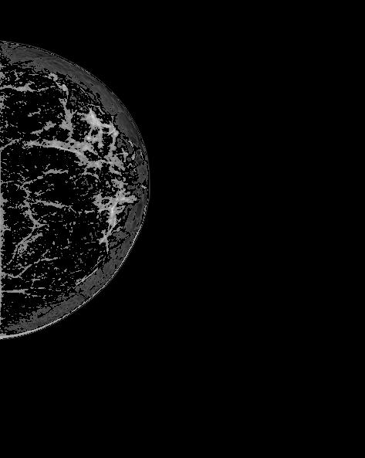
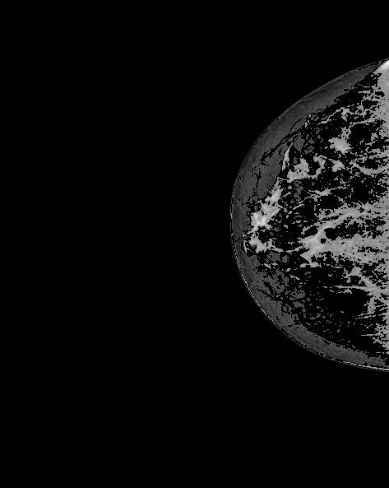
General Information
In 2015, my projects called CCC cancer cell classification has been selected to be funded by Project VI-SEEM which is run in jordan by SESAME
Notes:
My doctorate degree is in Computer science and Artificial Intelligence. My PhD study was fully funded by home univeristy Tafila Technical University and the Ersmus Mundas projects supported from European union

Slide 4

General Information
In 2019, the president of Tafila Technical University hired me beside of as an associated professor to manage the consultations, studies and training center
In 2023, I have been selected for FULBRIGHT SCHOLARSHIP to do again a POST-Doctorate research in University of Michigan-dearborn
Notes:
My doctorate degree is in Computer science and Artificial Intelligence. My PhD study was fully funded by home univeristy Tafila Technical University and the Ersmus Mundas projects supported from European union

Slide 5

Background Research
My interested research filed is in general in computer science. In more details, I prefer to do research in artificial intelligence and computer vision and image processing
I’d to developed news applications not only in medical applications but also in cyber physical system which is mainly coordinate by computer vision

Slide 6

Future Work
Two-View Mammogram Synthesis
Cyber Physical System

