Slide 1
Amro Aljadaa
Control Software Engineer @SESAME

Slide 2
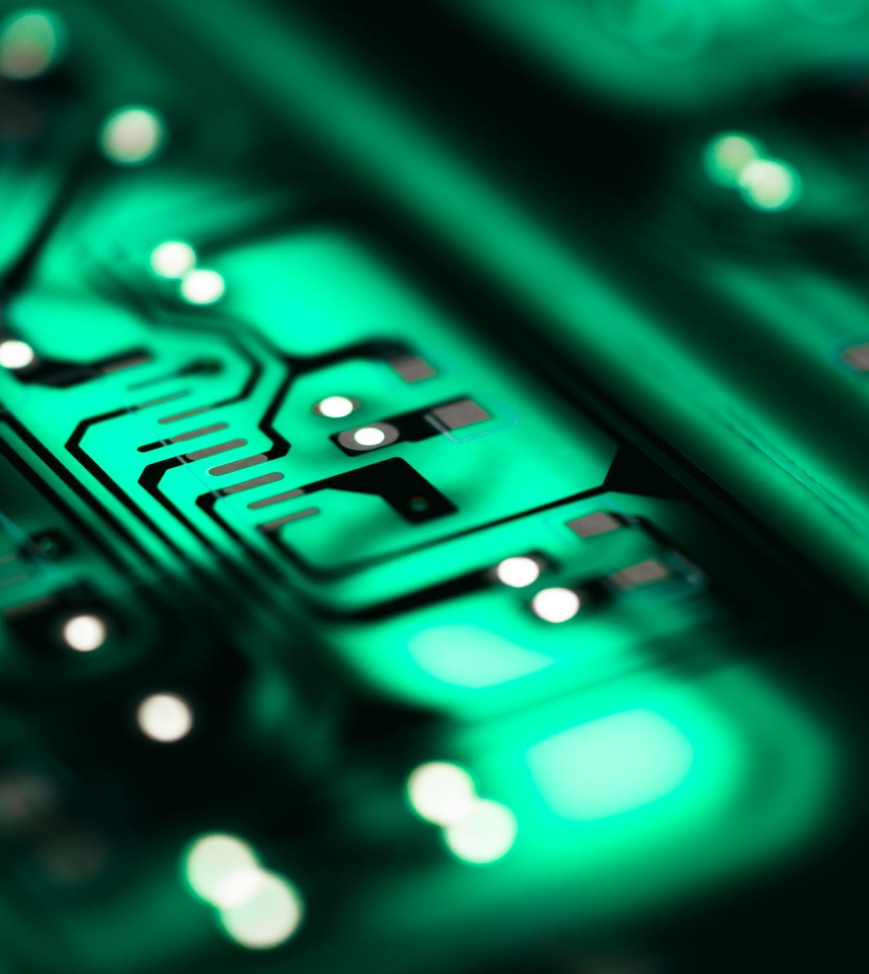
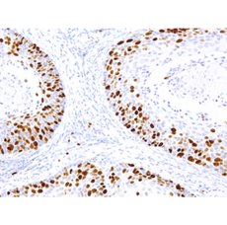
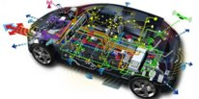
Background
Electrical Engineering
Embedded Systems
Image Processing & AI

Slide 3
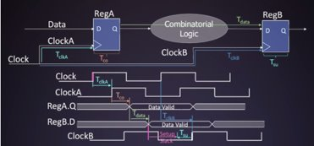
Background
Electronic design automation
Robotics

Slide 4
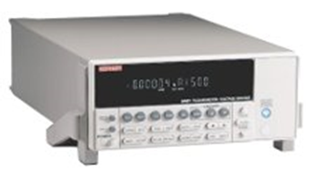
SESAME
We use C++ to:
Develop graphical user interfaces using Qt
Develop Drivers for controllers

Slide 5
SESAME
We use Python to write scripts that perform various services for the machine, including:
monitoring machine performance
Controlling motors
Image Processing
Event driven systems

Slide 6
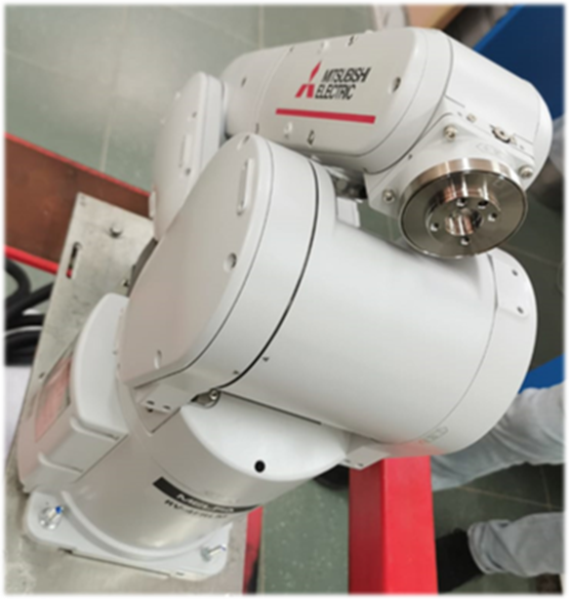
ARM Robot
Sample changing in MS beamline
State driven control
Safety features
Interface the arm with the controller and the sensors

Slide 7
Software Management
Docker for Containerizing IOCs and GUI projects
Eases maintaining and managing them in different environments.
This will make the IOCs portable and able to run on any operating system on any machine - with docker installed - without worrying about dependencies and versions.
Moving from development to production is very fast.
CI/CD on the way!

Slide 8
Fast Orbit Feedback
Correct beam position in the ring
code in C++ and efficiency is extremely important

Slide 9
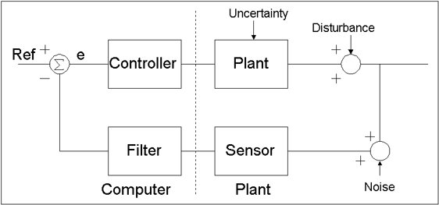
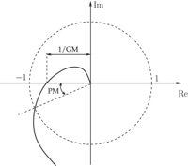
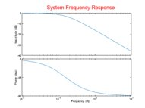
Control System Design

Slide 10
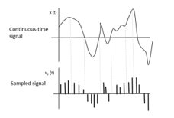
Sampling
Digital filters​
Digital Signal Processing

Slide 11
Thank You!

