Slide 1
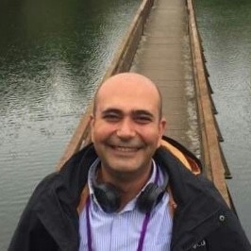
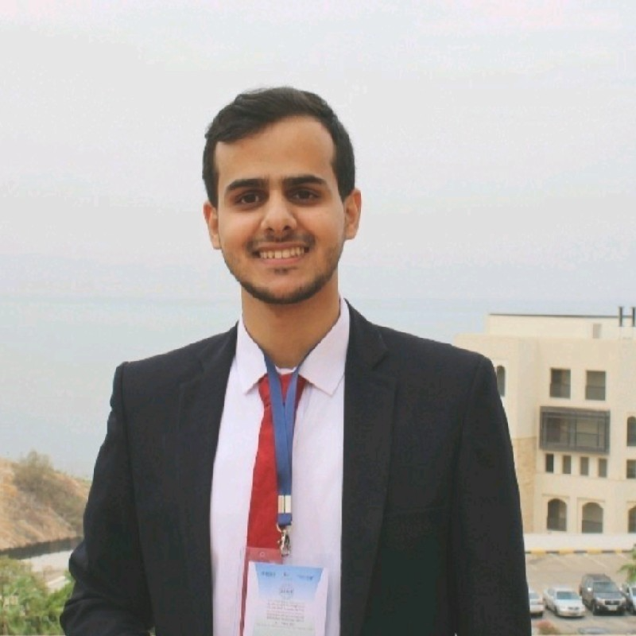
INFN ESC@SESAME
Data Collection & Analysis Team
Anas Mohammad*
Experimental Data Engineer @SESAME -April 2022-
BSc. in Mechatronics Engineering from HU -2021-
Mustafa Alzubi Data Collection & Analysis Team supervisor
Anas Mohammad*
*anas.mohammad@sesame.org.jo

Slide 2
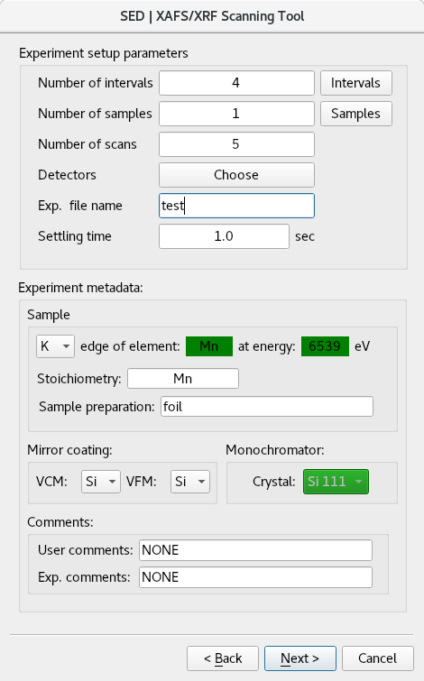
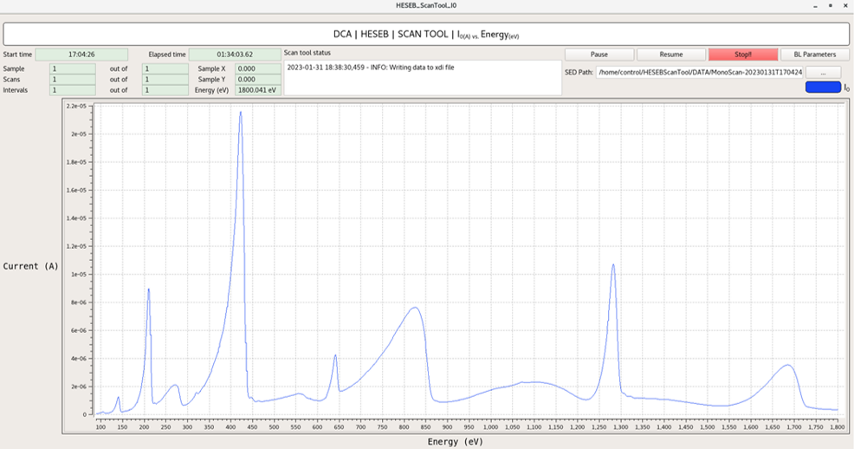
DCA | Mission & Responsibility
Data Collection and Analysis team is:
- responsible for providing the essential pre-processing and post-processing tools that are needed to make the data ready for users and scientists to start their own analysis.
Live data plotting
UI scanning tool
- mainly responsible for ensuring that the experimental data is not randomly generated by acquiring the experimental data and its metadata from the beamlines and other sources, store them together in a stander and well-defined file formats.

Slide 3
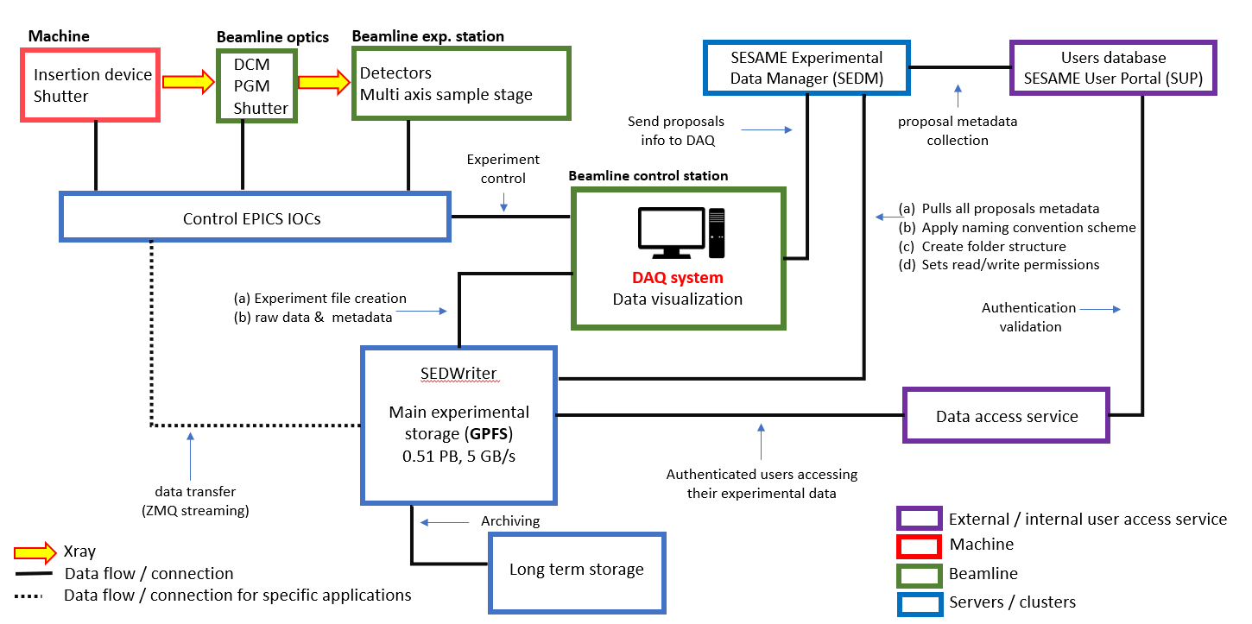
DAQ General Pipeline
The diagram below shows a general layout of the systems and instruments that are needed for obtaining experimental data at SESAME.

Slide 4
DAQ | Big Data Acquisition System | BEATSWriter
BEATSH5Writer: run the parallel receiving and writing processes
Queue
ADZMQ Streaming
Front
Write data in dxFile
Receive ZMQ frames (ZMQ2Queue)
ZMQ data writing (RAM2H5)
Image: 2560 x 2160 put frame in its location
Header decoding & get frame from buffer
Rear
Frame array: 1x5529600 & streamed datasets
Process streamed datasets and reshape image array

Slide 5
DAQ | Big Data Acquisition System | BEATSWriter
BEATSWriter: Components |run the parallel receiving and writing processes
ZMQ data writing (RAM2H5)
Receive ZMQ frames (ZMQ2Queue)

Slide 6
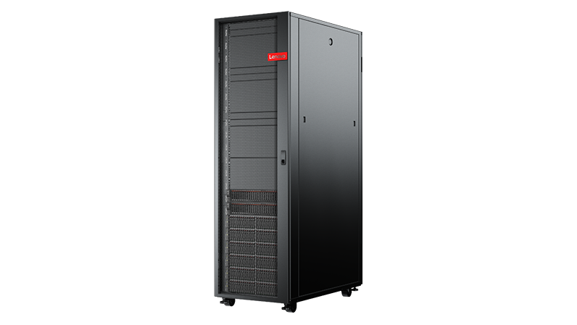
HPC | BEATS Cluster | CUDA
HPC Cluster
First 3D tomography images from BEATS
#!/bin/bash
#SBATCH --job-name=BEATS_rec_%j
#SBATCH --output=BEATS_rec_%j.out
#SBATCH --error=BEATS_rec_%j.err
#SBATCH --ntasks=48
#SBATCH --cpus-per-task=2
#SBATCH --time=00:30:00
#SBATCH --partition=cpu
#SBATCH --mem-per-cpu=2
# Modules section:
ml load anaconda/tomopy
Reconstruction Job run on GPU node
python BEATS_recon.py /PETRA/SED/BEATS/IH/glass_speres_coral-20230519T190251/red_sea_coral-20230519T190251.h5 --recon_dir/PETRA/SED/BEATS/IH/tmp/recon --work_dir /PETRA/SED/BEATS/IH/tmp --cor_methodtomopy --ncore 92

Slide 7
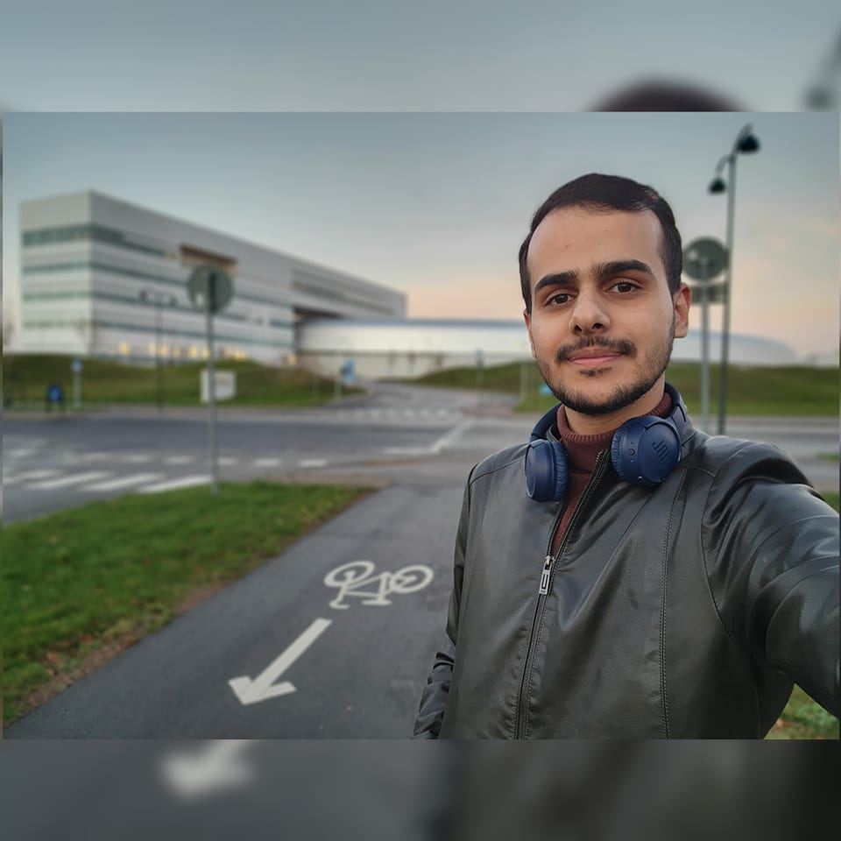
DAQ | SESAME MAXIV Fellowship
SESAME-MAXIV Fellowship
31 Oct, 2022 – 30 Dec 2022
Data Acquisition System -More focus on hardware and continuous scan technique

Slide 8
Triggering System | PandABox
PandABox is a fully integrated position, acquisition and control system with GTX-CLK0 up to125MHz.

Slide 9
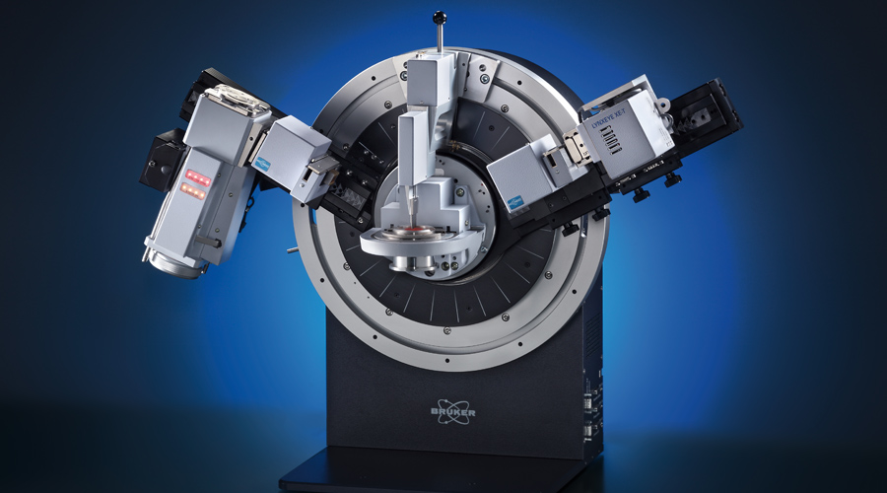
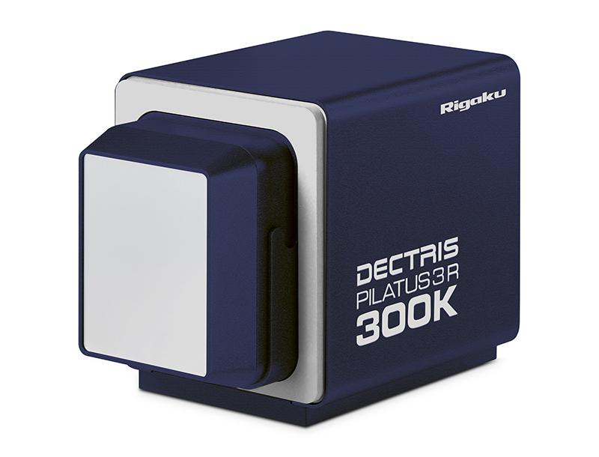
OnFly Scan | Fast Data Acquisition | MS Beamline
PandABox
Encoder Readouts
TTL triggers
Captured data
Streamed Big data
Parallel programming C++
Reshaping, Extract ROI from each frame, apply some basic operations
Frequency 500Hz
Processed data

Slide 10
DAQ | Thanks!
Thanks!
Any Question!

