Slide 1
ABOUT/// Ibrahim Foudeh Scientific Computing and Systems Communications
ABOUT ME
A highly professional, successful, and fully qualified Linux System Engineer holding many international professional certifications. with proven success in evaluating, installing, and implementing virtualization, compute technologies while providing ongoing management for existing Linux, EXSI , Windows and operating systems & aligning business goals with technology solutions through driving improvements, led IT operations and systems..

Slide 2
EXPERIENCE /// Ibrahim Foudeh
Ride Operator
Analog Layout engineer
Technical Consulting Engineer
Linux System Engineer
06/2016 - 09/2016,
08/2018 - 03/2020,
06/2020 – 07/2022
08/2022 - Present,
Cedar Point Fair
Golden Electronics
Cisco Inc. (Vendor ESTARTA)-
SESAME

Slide 3
JOB Description/// Ibrahim Foudeh
Linux System Engineer
As a Linux System Engineer, i'm managing and optimizing Linux-based infrastructure to ensure high availability, security, and performance, in addition to operating the IT infrastructure and computing resources at SESAME Install, configure, manage and commissioning Linux servers, workstations and desktops, include automation of servers configuration and deployment. - Maintaining a heterogeneous Linux and Windows environment and to handle the required configuration for authentication, authorization and integration via directory services (Windows Active Directory). - Troubleshoot systems, and applications problems to identify and correct the malfunctions and other operational difficulties and to take the corrective actions. - Manage Linux platform distribution, testing and production environment, with a stable release with all subsystems and stakeholders. - Automation of day to day administration tasks using the Bash , python , ansible. - optimize the memory and space allocation as we have very limited resource. - Rebuild the enterprise Linux kick-start platform automation, considering hardware,LAN, end-user and pre/post scripts. - Establish and handle the centralized configuration management.

Slide 4
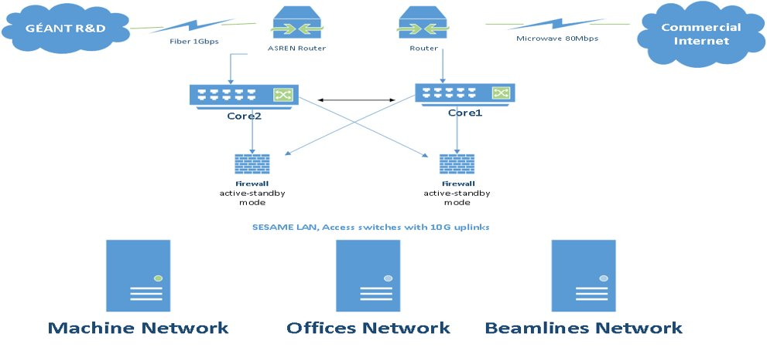
Challegenes/// Ibrahim Foudeh
Challenges
- optimize the memory and space allocation as we have very limited resource -Automation of day-to-day administration tasks using the Bash , python , ansible. -the stability of heterogeneous Linux and Windows environment.

Slide 5
Projects and achievements /// Ibrahim Foudeh
On going projects
- PXE Server with zero click. - Linux @ SESAME - Migration from Centos 7 to Rocky linux 8.6 - online portal for all sesame online services - upgrading and maintain the cluster management portal - SUP development

Slide 6
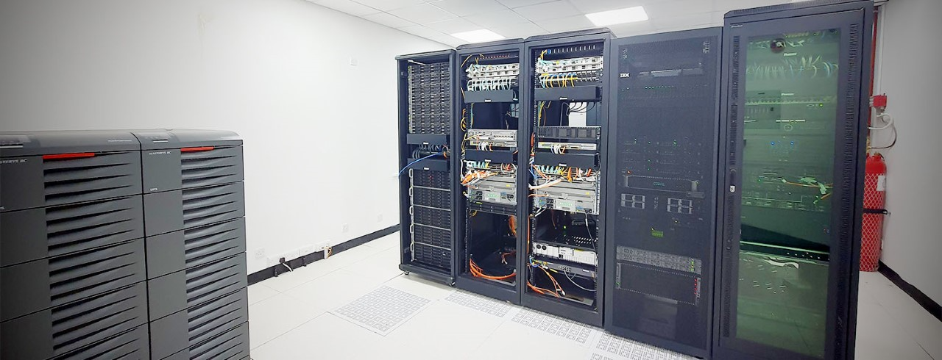
Data Center /// Ibrahim Foudeh

Slide 7
CONTACT /// Ibrahim Foudeh
+962796334772
Amman, Shafa Badran
+962786430475
ibrahim.Foudeh@sesame.org.jo

Slide 8
Ibrahim Foudeh
THANKS!

