Slide 1



Real-Time Data Acquisition
and Processing for High-Resolution
Synchrotron Micro-Tomography
Data Collection & Analysis Team @SESAME
Anas Mohammad*
Experimental Data Engineer
Mustafa Alzubi
Team Leader

Slide 2




Overview
Challenge: BEATS beamline generates up to 2TB daily at speeds reaching several GB/s
Problem: Time gap between receiving camera frames and writing them to storage
Solution: Developed BEATSH5Writer with circular buffer indexing in C++ for real-time performance
Result: Real-time data writing with zero frame losses at maximum camera throughput
SESAME Synchrotron | Data Collection & Analysis| 2026

Slide 3
BEATS Beamline Overview
2560×2160
100 FPS
1.14 GB/s
2 TB/day
Resolution
Frame Rate
Throughput
Data Volume
Capabilities
Infrastructure
Non-destructive 3D imaging (SRCT)
High-resolution microscopic imaging
Thousands of projections per scan
3D volumetric reconstruction
PCO edge 5.5 / FLIR Oryx cameras
CPU/GPU reconstruction cluster
0.5 PB GPFS + tape archival
100 Gbps InfiniBand network
Challenge: Time gap between receiving frames and writing to storage grows with dataset size
SESAME Synchrotron | Data Collection & Analysis| 2026

Slide 4
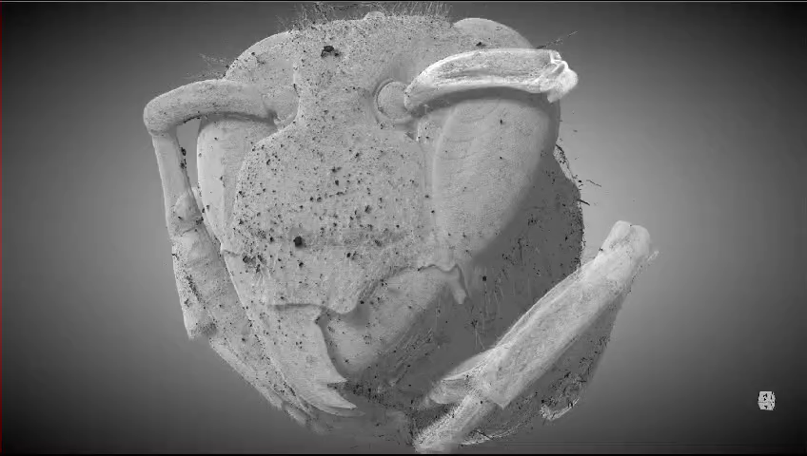

Slide 5
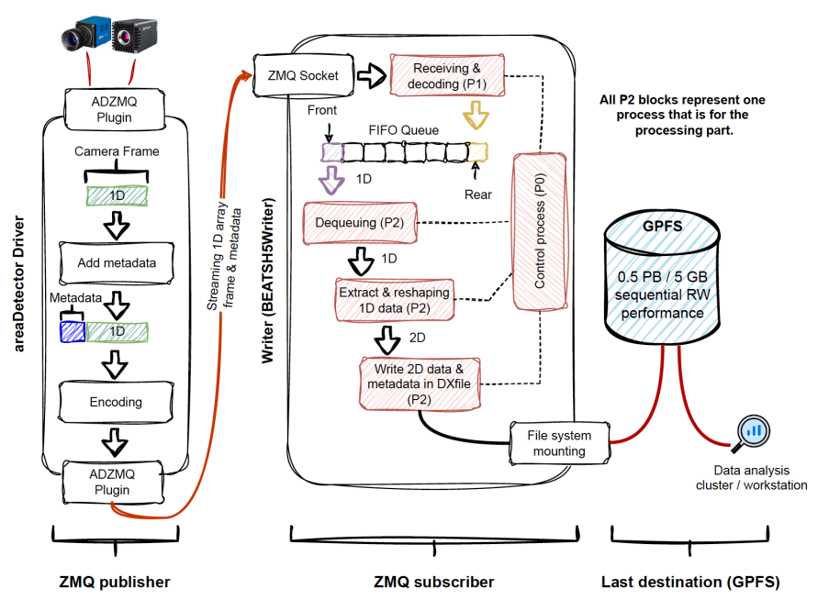
System Architecture
Key Design Principles
✓
Direct streaming to storage - no local buffering at beamline
✓
Real-time ZeroMQ data transmission over 100 Gbps InfiniBand
✓
HDF5-DXfile format standard for tomography data
SESAME Synchrotron | Data Collection & Analysis| 2026

Slide 6
The Problem: Growing Time Gap
Writer Performance - Python Implementation
Root Causes
Dequeuing from FIFO queue
1D → 2D array reshaping
CPU-intensive operations
Queue size degradation
Limitation
Still 3.5× slower
than receive time
Queue bottleneck
remains
SESAME Synchrotron | Data Collection & Analysis| 2026

Slide 7
Memory Management Challenge
Why Memory Became the Bottleneck
Initial System (96 GB RAM)
Upgraded System (192 GB RAM)
Max: ~8,000 frames (88.4 GB)
Queue grows with frame count
Access time degrades
Insufficient for large scans
Max: ~17,000 frames (188 GB)
Supports worst-case: 14,000 frames
Buffer headroom for processing
Ready for optimization attempts
Frame Data in Memory
1D Array from Camera
5,697,500 pixels × 16-bit = 11.4 MB per frame
Reshaping Required: 1D → 2D (2560 × 2160)
SESAME Synchrotron | Data Collection & Analysis| 2026

Slide 8
Our Solution Journey
1
RAM Upgrade
Baseline capacity
96 GB → 192 GB
2
Python Parallel
~4× improvement
4 workers + static hashing
3
Shared Memory
Failed at 6K frames
Direct memory access
4
C++ Ring Buffer
Real-time success! ✓
Smart pointers + HDF5 API
SESAME Synchrotron | Data Collection & Analysis| 2026

Slide 9
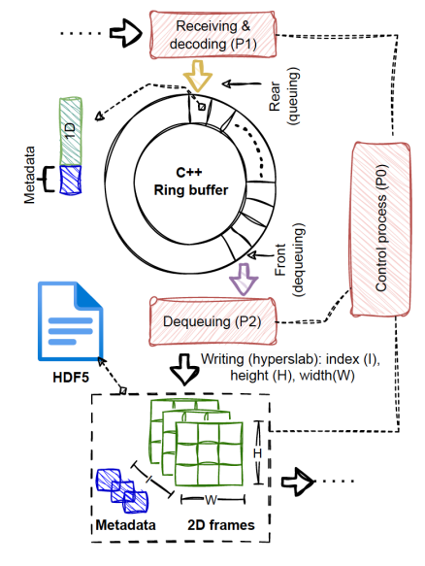
C++ Ring Buffer Implementation
Ring Buffer Structure
std::vector<std::unique_ptr<std::pair<std::string, std::vector<size_t>>>>
std::vector for dynamic sizing
reserve() pre-allocates memory
Smart pointers prevent memory leaks
std::unique_ptr ensures ownership
std::move semantic
std::pair handles JSON metadata
size_t for dynamic frame sizes
Key Advantages
SESAME Synchrotron | Data Collection & Analysis| 2026

Slide 10
Final Performance Achievement
C++ Ring Buffer: All Implementations Compared
@ 3000 Frames
C++ Time:
36.7s
Receive:
23.2s
Difference:
13.5s
Performance Gains
70% faster
than original
Near real-time:
Write ≈ Receive
SESAME Synchrotron | Data Collection & Analysis| 2026

Slide 11
Production Deployment Results
Stress Test
Results
20 consecutive experiments
15,000 frames each @ 100 FPS
Maximum resolution (2560×2160)
3.1 TB total data
✓ Zero frame losses
✓ Sustained 1.14 GB/s I/O
✓ No cached data
✓ 100% success rate
584
23.8 TB
100%
0
Experiments
Data Collected
Reliability
Frame Losses
In production
Successfully
Zero failures
Perfect capture
SESAME Synchrotron | Data Collection & Analysis| 2026

Slide 12

Impact & Contributions
Technical Innovation
Scientific Impact
Ring buffer with smart pointers for memory management
Immediate data availability accelerates research
Identified queue access as bottleneck in high-throughput pipelines
Enables demanding high-throughput experiments
Software-based solution without specialized hardware
Template for other synchrotron facilities worldwide
Documented open-source solution on GitHub
Contribution
This work has been submitted in IEEE Transaction
SESAME Synchrotron | Data Collection & Analysis| 2026

Slide 13
Thank You
Questions & Discussion

