Slide 1
Linux Administration Workshop
Advanced topics in Linux
Ibrahim Foudeh
SESAME
(21/4/2025) session start at 9:00 AM UTC

Slide 2
Workshop Objectives
Understand Linux networking fundamentals.
Configure SSH for secure remote access.
Share files across OS’s with Samba and NFS.
Set up basic infrastructure services.

Slide 3
Agenda
Networking Basics
Static/Dynamic IP Configuration
DNS, DHCP, NTP
SSH Deep Dive
Samba Setup & Demo
NFS Setup & Demo
Q&A

Slide 4
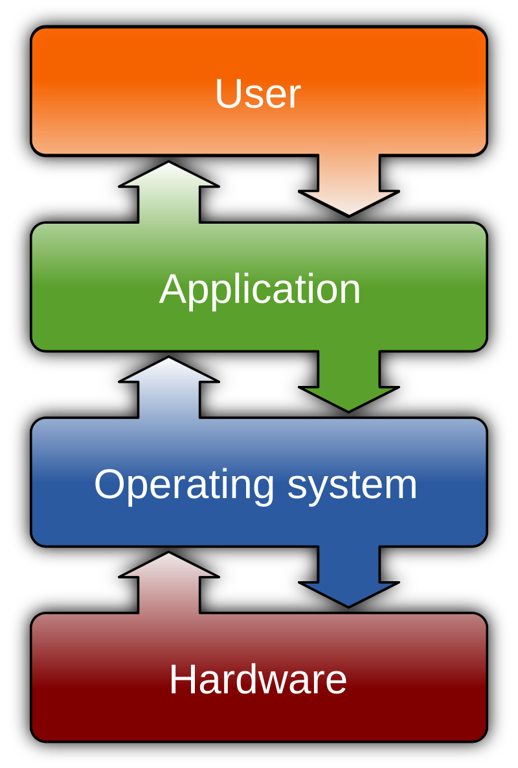
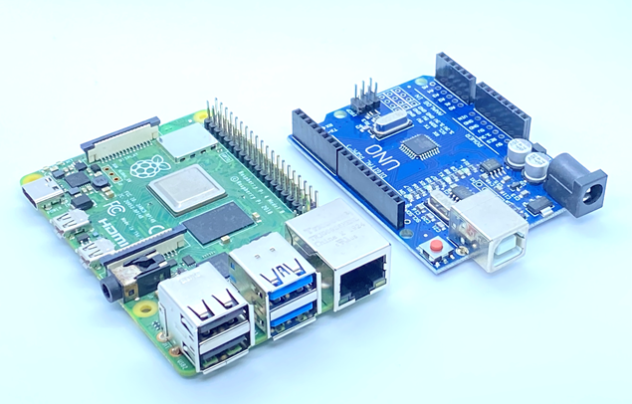
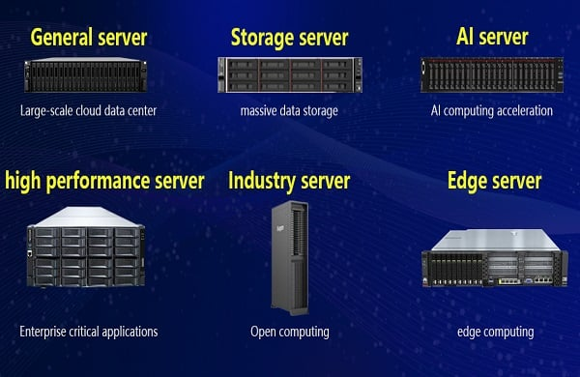
What is Operating system?

Slide 5
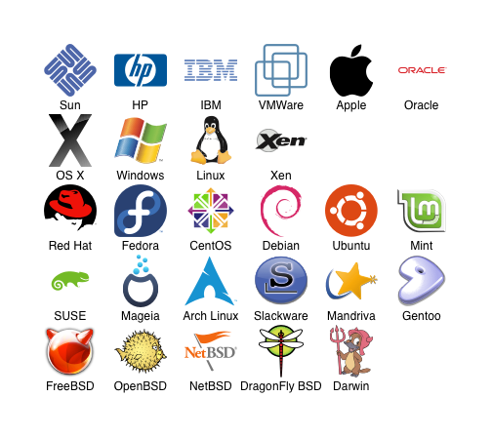
What is Operating system?
An operating system (OS) is the program that, after being initially loaded into the computer by a boot program, manages all the other application programs in a computer. The application programs use the OS by requesting services through a defined application program interface (API)

Slide 6
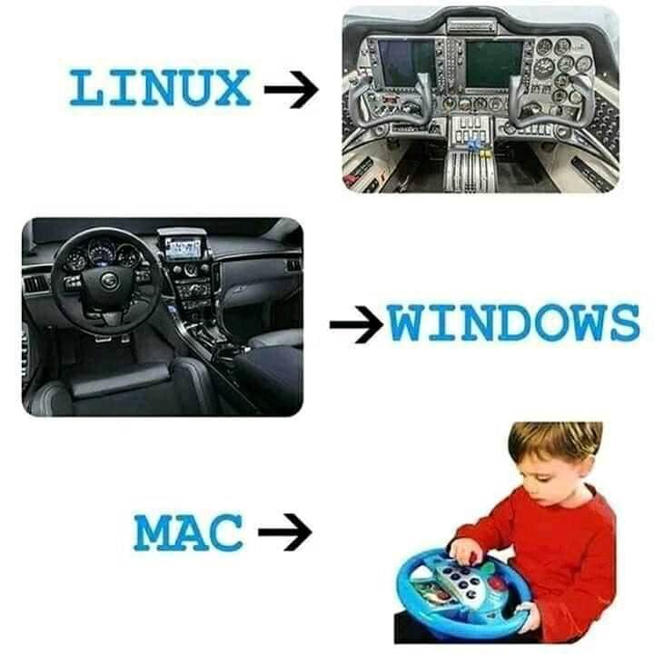

Slide 7
OSI model

Slide 8
Understanding Networking Fundamentals
Layer 3 of the OSI Model: Network Layer provides the functional and procedural means of transferring variable length data sequences from a source host on one network to a destination host on a different network, while maintaining the quality of service requested by the transport layer (in contrast to the data link
IP Addressing
IP addresses are used to identify devices on a network. IPv4 uses 32-bit addresses, while IPv6 uses 128-bit addresses. IPv4 example: 192.168.1.100 IPv6 example: 2001:db8::1

Slide 9
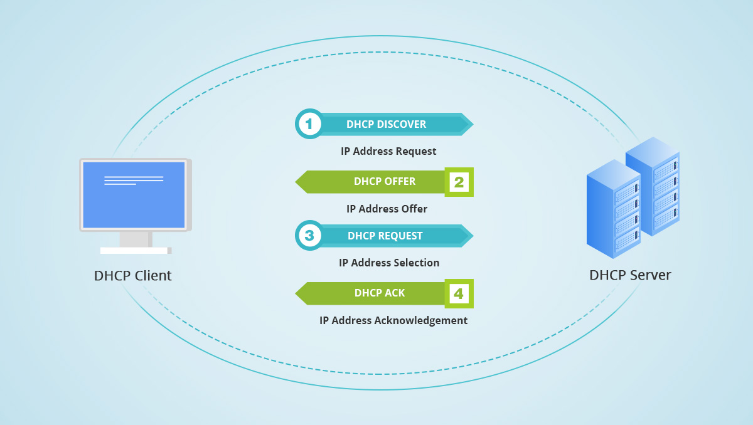
DHCP
Dynamic Host Configuration Protocol DHCP is a network protocol that helps us to assign an IP address and related IP information to the devices such as servers

Slide 10
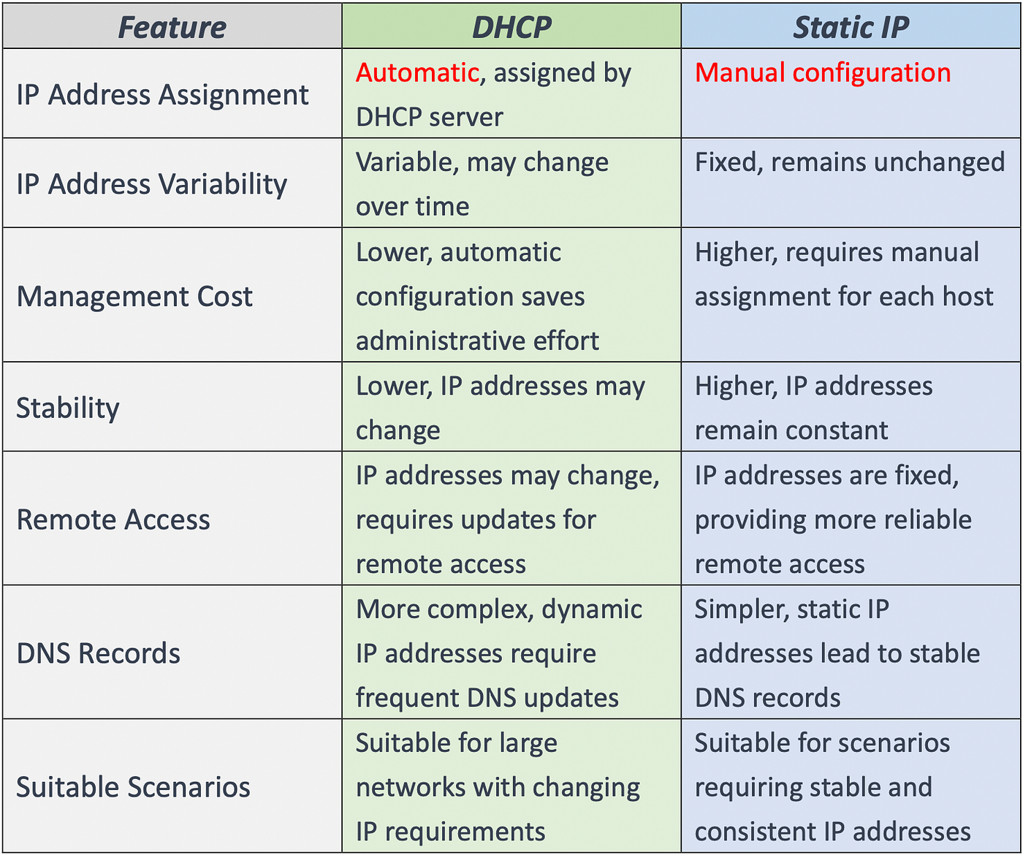

Slide 11
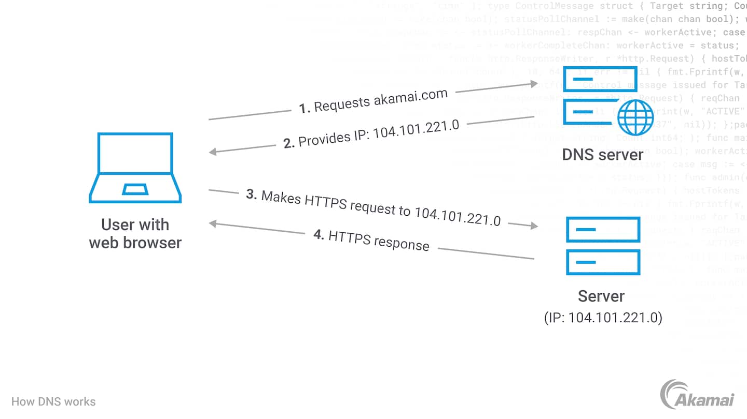
DNS
Domain Name System (DNS) is used to convert a website name like FS.com to its IP address and vice versa, making users connect to websites by matching human-readable domain names with the unique ID of the server.

Slide 12
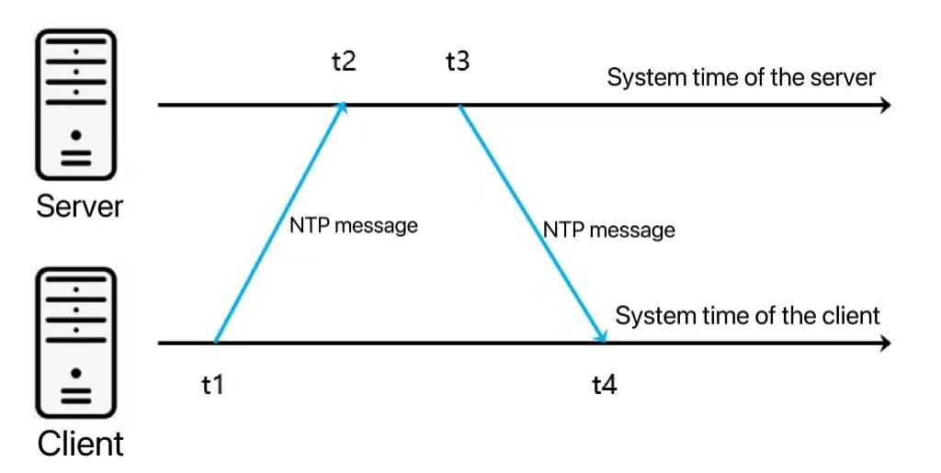
NTP
Network Time Protocol (NTP) is an internet protocol used to synchronize with computer clock time sources in a network.

Slide 13
Essential Networking Tools
Directory | Purpose
ip/ifconfig | Use it to display network interfaces and routing tables.
nmcli | Command-line tool for Network Manager. It lists and activates network connections.
nmtui | GUI tool for Network Manager. It lists and activates network connections.
ping | Test network connectivity. For example, ping Google's DNS server at 8.8.8.8.
netstat/ss | Display network connections and listening ports. Great for troubleshooting.

Slide 14
Configuring Network Interfaces via CLI
Using `nmcli`
Create, modify, and manage network connections. Set static IP addresses, gateways, and DNS.
Static IP Configuration
Set the IP address, gateway, and DNS server. Activate the connection after changes.
Editing Configuration Files
Modify `/etc/sysconfig/network-scripts/ifcfg-`. This is an alternative, less common approach.

Slide 15
Configuring Network Interfaces via CLI
Using `nmcli`
sudo nmcli con mod "ens33" ipv4.addresses 192.168.1.101/24
sudo nmcli con mod "ens33" ipv4.gateway 192.168.1.1
sudo nmcli con mod "ens33" ipv4.dns "8.8.8.8"
sudo nmcli con mod "ens33" ipv4.method manual
sudo nmcli con down "ens33" && sudo nmcli con up "ens33"

Slide 16
Secure Shell (SSH): Secure Remote Management
SSH was created in 1995 by Tatu Ylönen to replace insecure protocols. It's commonly used for remote server administration, file transfer, and tunneling.

Slide 17
SSH Fundamentals
Protocol Overview
SSH uses encryption, authentication, and integrity checks.
Key Components
It comprises an SSH client and an SSH server.
Port 22
The default port is 22, but it's a best practice to change it.
SSH relies on TCP for reliable communication.

Slide 18
Practical SSH Usage: Basic Commands
Connect
`ssh user@host`
Copy Files
`scp file user@host:directory`
File Transfer
`sftp user@host`
Example: `ssh -p 2222 user@example.com` connects on port 2222.

Slide 19
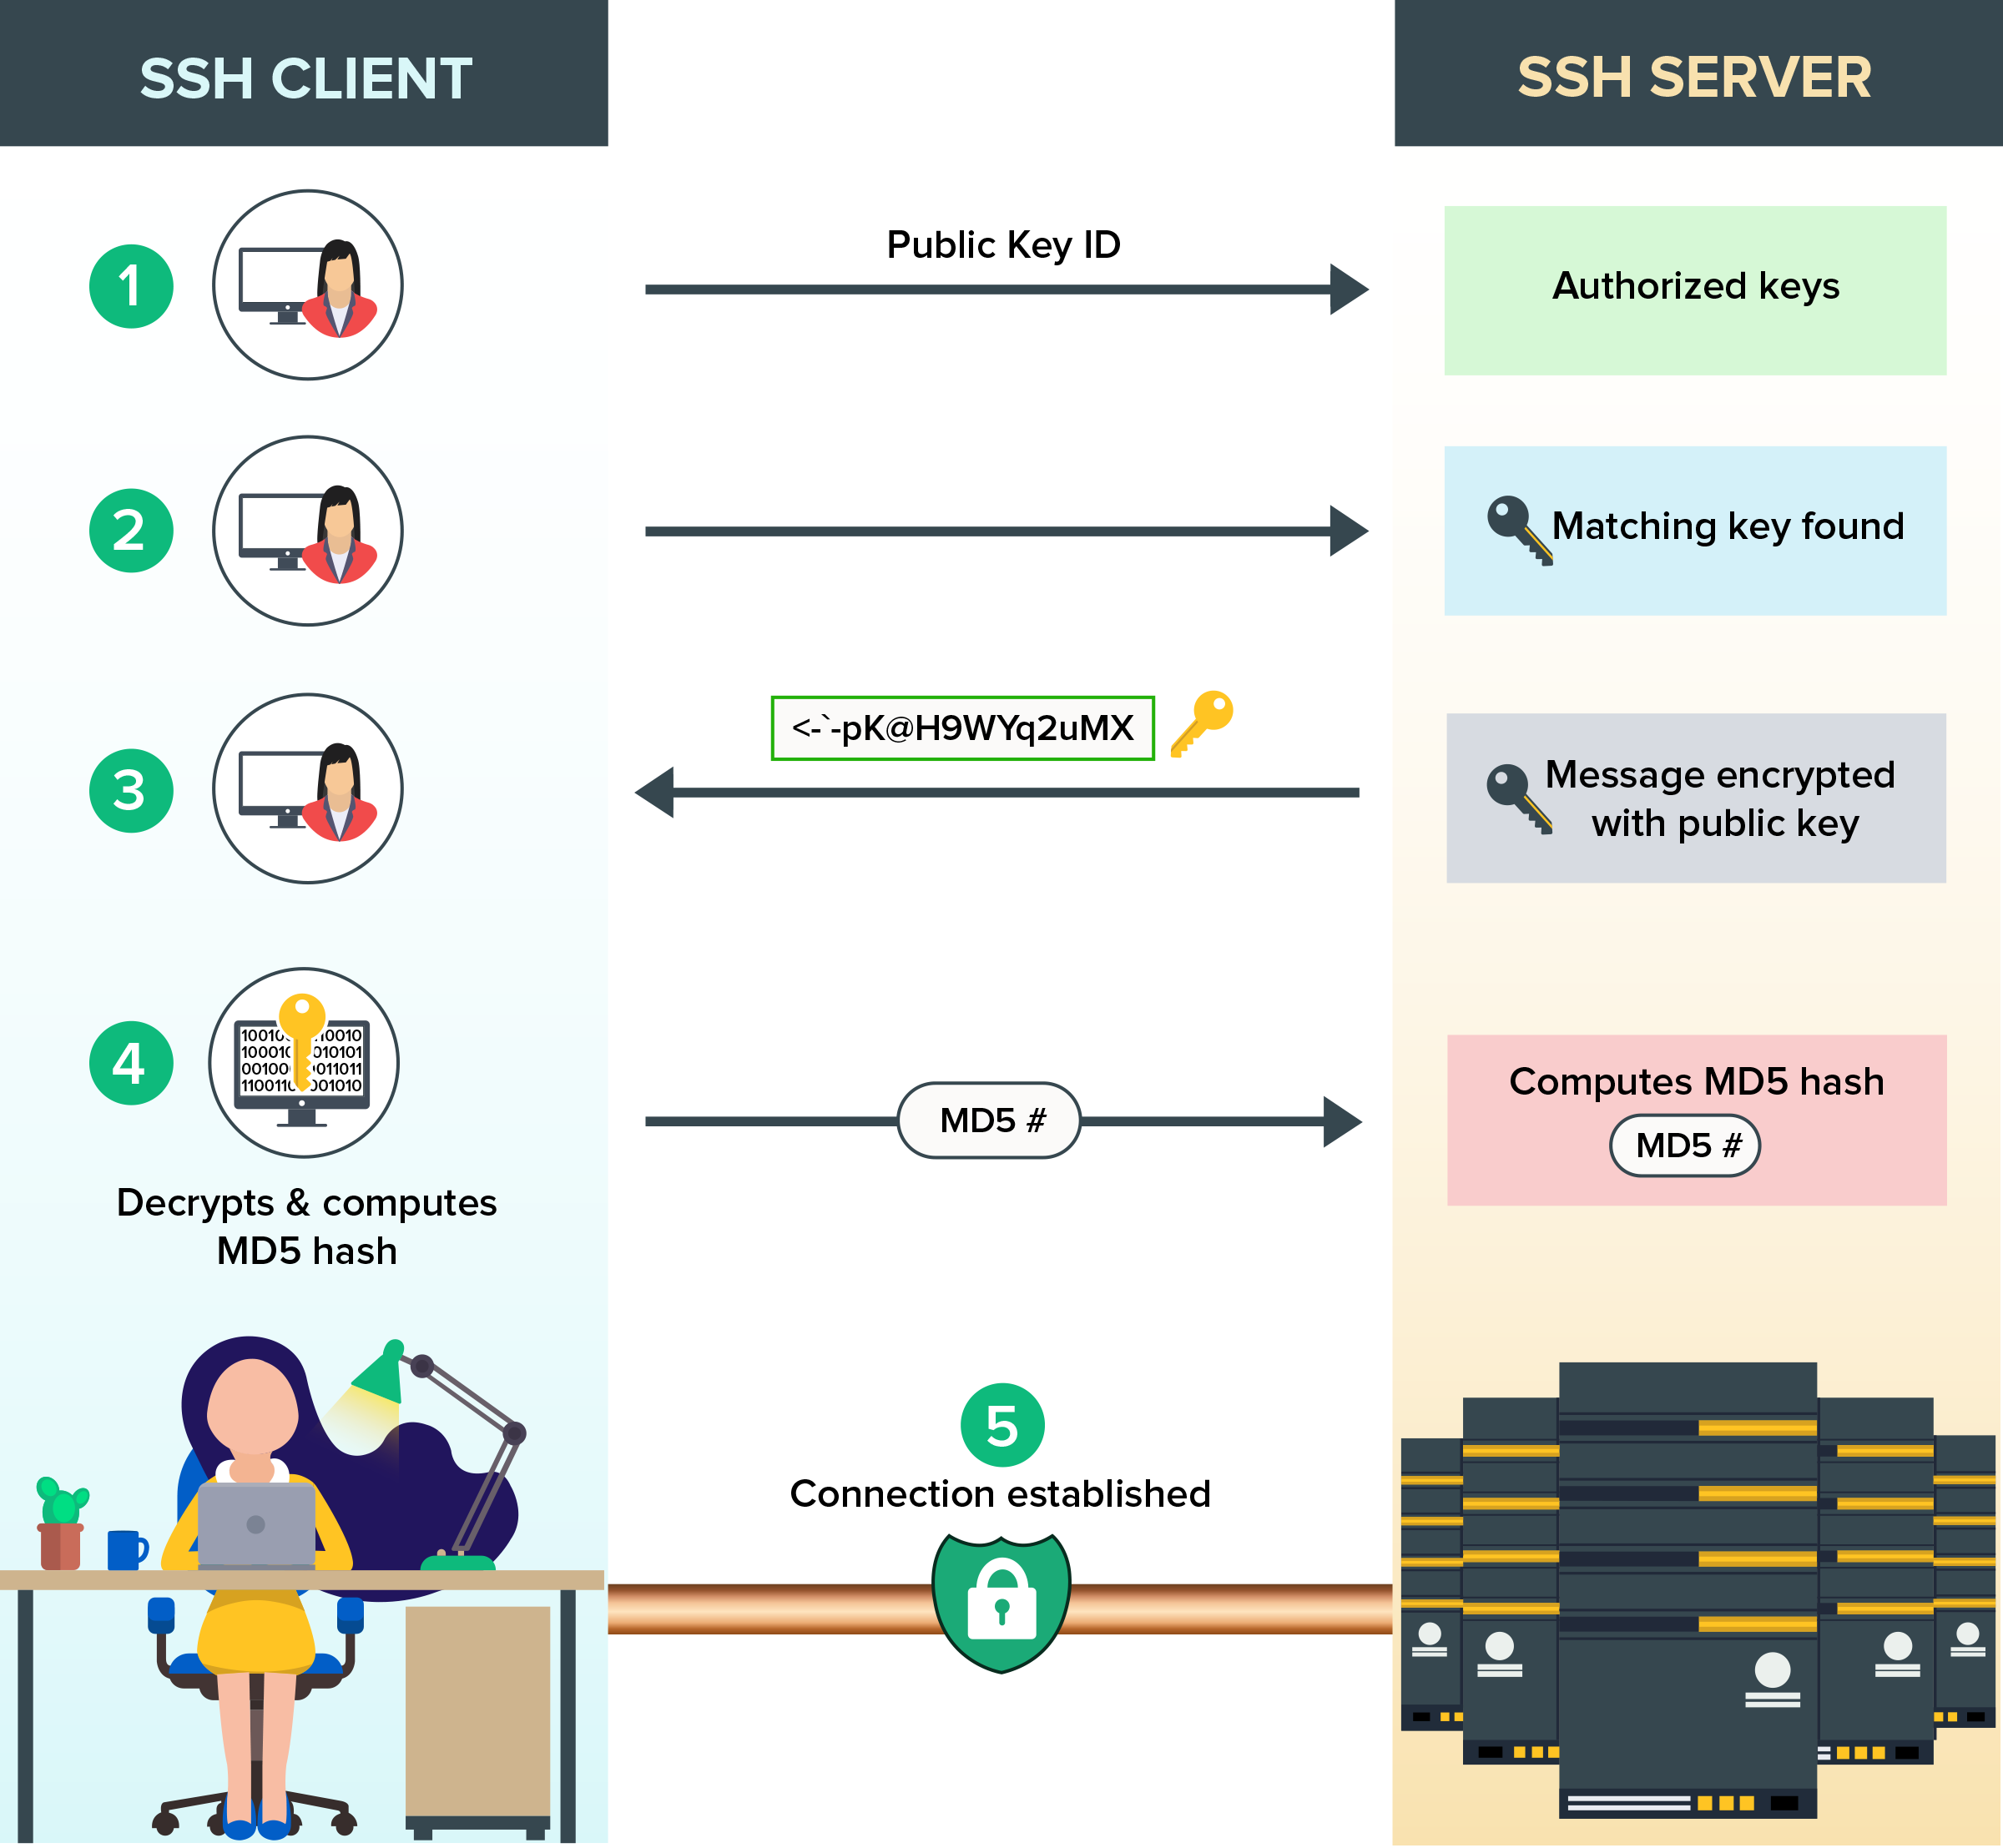
SSH key authentication

Slide 20
How to Set Up SSH Keys
Step 1 — Creating the RSA Key Pair
Step 2 — Copying the Public Key to Your Rocky Linux Server
ssh-keygen
ssh-copy-id username@remote_host

Slide 21
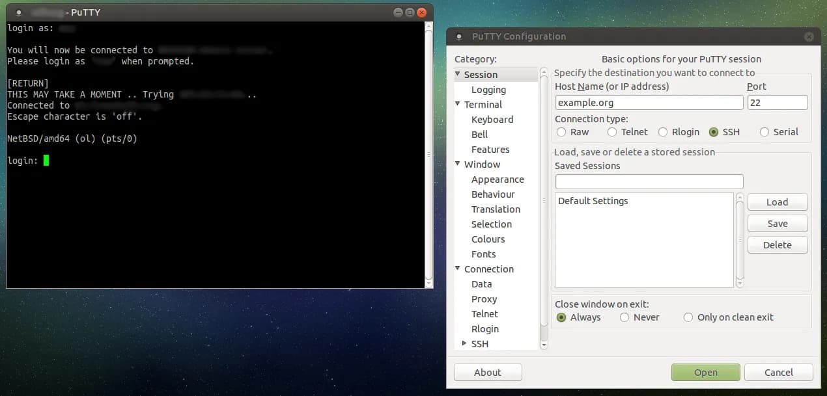
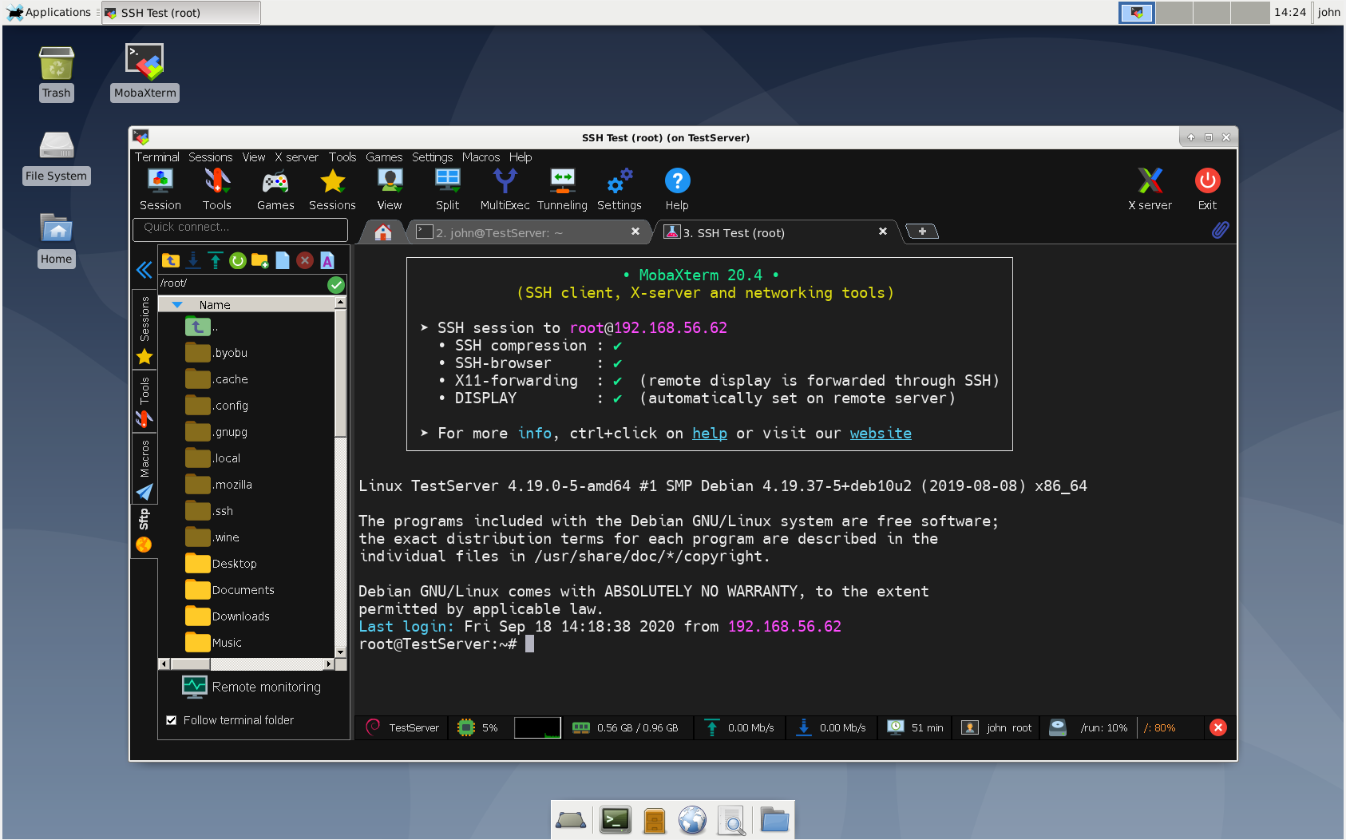
How to connect to remote server

Slide 22
How to configure NFS Mount
Step 1 — Downloading and Installing the Components
Step 2 — Creating the Share Directories on the Host
sudo dnf install nfs-utils
sudo mkdir /var/nfs/school -p

Slide 23
How to configure NFS Mount
Step 3 — Configuring the NFS Exports on the Host Server
sudo vim /etc/exports
directory_to_share client(share_option1,...,share_optionN)
/var/nfs/general client_ip(rw,sync,no_subtree_check)
/home client_ip(rw,sync,no_root_squash,no_subtree_check)
/var/nfs/school * (rw,sync,no_root_squash,no_subtree_check)
sudo systemctl enable nfs-server
sudo systemctl start nfs-server

Slide 24
How to configure NFS Mount
Step 4 — Adjusting the Firewall on the Host
firewall-cmd --permanent --list-all | grep services
firewall-cmd --permanent --add-service=nfs
firewall-cmd --permanent --add-service=mountd
firewall-cmd --permanent --add-service=rpc-bind
firewall-cmd --reload

Slide 25
How to configure NFS Mount
Step 5 — Creating Mount Points and Mounting Directories on the Client and install needed packages
sudo dnf install nfs-utils
sudo mkdir -p /nfs/general
sudo mkdir -p /nfs/home
sudo mkdir -p /mnt/test3
sudo mount host_ip:/var/nfs/general /nfs/general
sudo mount host_ip:/home /nfs/home
Sudo mount host_ip:/var/nfs/school /mnt/test3
df –h

Slide 26
How to configure NFS Mount
Step 6 — Testing NFS Access
Step 7 — Mounting the Remote NFS Directories at Boot
Step 8 — Unmounting an NFS Remote Share
sudo nano /etc/fstab
host_ip:/var/nfs/general /nfs/general nfs auto,nofail,noatime,nolock,intr,tcp,actimeo=1800 0 0
host_ip:/home /nfs/home nfs auto,nofail,noatime,nolock,intr,tcp,actimeo=1800 0 0
<server_ip>:/sharedir /mnt/client_share nfs defaults 0 0
sudo umount /nfs/home
sudo umount /nfs/general

Slide 27
Questions?

Slide 28
Thank You

