Slide 1
Linux Administration Workshop
Advanced topics in Linux
Ibrahim Foudeh
SESAME
(23/4/2025) session start at 9:00 AM UTC

Slide 2
Workshop Objectives
Understand system services
Learn about filtering and redirection tools
Share files across OS’s with Samba .
Set up ansible server for automation.

Slide 3
Agenda
System Monitoring
Log Analysis
Redirection & Filtering
Process Management
PXE Server Basics
Ansible Automation
Q&A

Slide 4
How to configure SAMBA Mount
Step 1 — Downloading and Installing the Components
Step 2 — Creating the Share Directories on the Host and assign permission
dnf install samba samba-common samba-client
sudo mkdir /var/nfs/school2 –p
sudo chmod -R 755 /var/nfs/school2
sudo chown -R nobody:nobody /var/nfs/school2

Slide 5
How to configure SAMBA Mount
Step 3 — Configuring the smb.conf on the Host Server and test the parameter
sudo vim /etc/samba/smb.conf
[Public]
path = /var/nfs/school2
browsable =yes
writable = yes
guest ok = yes
read only = no
directory_to_share client(share_option1,...,share_optionN)
sudo testparm

Slide 6
How to configure SAMBA Mount
Step 4 — Adjusting the Firewall on the Host
firewall-cmd --permanent --list-all | grep services
sudo firewall-cmd --permanent --add-service=samba
sudo firewall-cmd --reload
sudo firewall-cmd --list-services

Slide 7
How to configure SAMBA Mount
Step 5 — Accessing Samba Share from Windows
\\server-ip

Slide 8
How to configure SAMBA Mount
Step 6 — Secure Samba Share Directory
useradd smbuser
smbpasswd -a smbuser
sudo groupadd smb_group
sudo usermod -g smb_group smbuser
sudo vim /etc/samba/smb.conf
[Puplic]
path = /mnt/test1
valid users = @smb_group
guest ok = no
writable = no
browsable = yes
sudo systemctl restart smb
sudo systemctl restart nmb

Slide 9
Processes management
What is the Process ?
Processes carry out tasks within the operating system. A program is a set of machine code instructions and data stored in an executable image on disk and is, as such, a passive entity; a process can be thought of as a computer program in action.

Slide 10
Processes management
Types of processes
The user process:
- is started from a terminal associated with a user
- accesses resources via requests or daemon
The system process (daemon):
- is started by the system
- is not associated with any terminal and is owned by a system user (often root)
- is loaded at boot time, resides in memory, and is waiting for a call
-is usually identified by the letter d associated with the process name

Slide 11
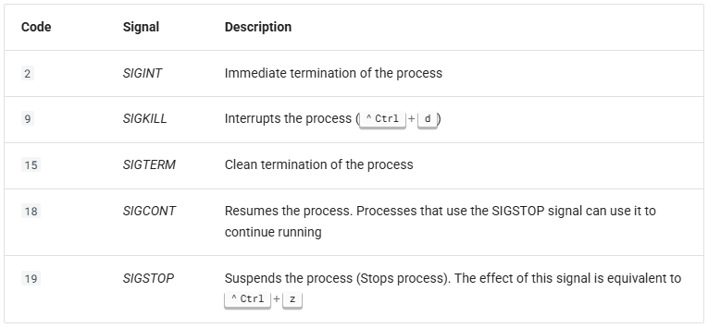
Process management controls
kill command
the kill command sends a stop signal to a process
Signals are the means of communication between processes. The kill command sends a signal to a process.
kill [-signal] PID

Slide 12
Process management controls
fg and bg commands
The fg command puts the process in the foreground, while the command bg places it in the background:
jobs command
Signals are the means of communication between processes. The kill command sends a signal to a process.
sleep 200 &
sleep 300
^Z # Suspend the second sleep command
jobs –l
fg %2 # Resume interacting with the second sleep command
^Z # Suspend it
bg %2 # Resume in the background

Slide 13
System monitoring tools
Live Monitoring:
Command | Purpose
Top/htop | process viewer
Ps | Running process viewer
Vmstat 1 | Virtual memory stats every 1s
Disk Usage Analysis
Command | Purpose
df -h | Disk free space
du -sh | Directory size
iostat | I/O statistics

Slide 14
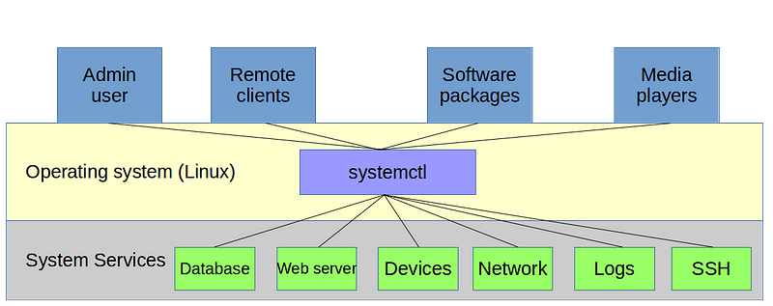
Manage services with systemctl
Systemd is a Systems and Services Administrator for Linux-based Systems. But, more broadly, it can also be described as a set of basic building blocks for a Linux System, as it provides a «Systems and Services Administrator » which runs as a process (PID 1) and starts the rest of the system.
systemctl command, which is the central management tool for controlling the Init system (Systems and services administrator initial of Unix systems).

Slide 15
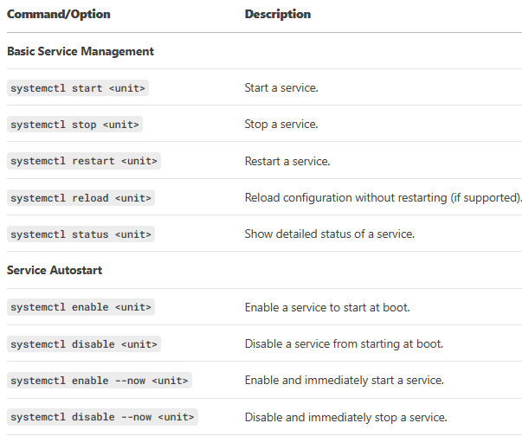
Manage services with systemctl

Slide 16
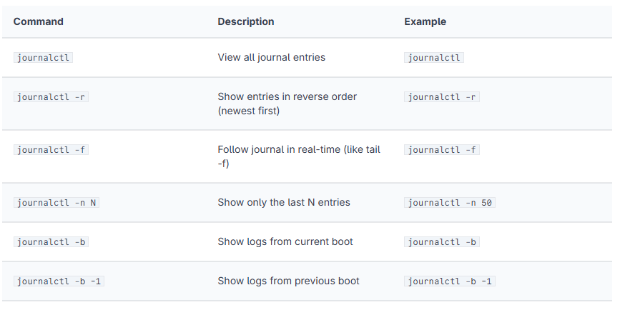
Log Management with journalctl
What is the use of Journalctl command?
Journalctl is a utility for querying and displaying logs from journald, systemd's logging service.
Important logs files to check
/var/log/syslog: General system logs.
/var/log/auth.log: SSH/Sudo attempts.
/var/log/kern.log: Kernel events.

Slide 17
Finding tool
Command | Purpose | Search Scope | Speed | Database Usage | Search Criteria | Output | Examples
locate | Find files/directories by name quickly. | Pre-built database (entire FS) | Very fast | Yes (updatedb) | Filename patterns (basic regex support) | Full paths of matching entries | locate *.log
find | Search files/directories in real-time with advanced filters. | Specified directory subtree | Slow | No (live search) | Name, size, time, permissions, type, etc. | Full paths of matching entries (customizable) | find /home -name "*.txt" -mtime -7
which | Locate the path of an executable in $PATH. | Directories in $PATH | Instant | No | Exact executable name | First matching executable path | which python

Slide 18
Redirection Operators
Tool/Operator | Description | Common Options/Usage | Examples
> | Redirect stdout to a file (overwrite). | command > file | ls > output.txt
>> | Redirect stdout to a file (append). | command >> file | echo "new line" >> log.txt
< | Redirect stdin from a file. | command < file | sort < unsorted.txt
2> | Redirect stderr to a file. | command 2> error.log | grep "error" logs.txt 2> errors.log
&> | Redirect stdout + stderr to a file. | command &> combined.log | python script.py &> output.log
| | Pipe stdout to another command. | command1 | command2 | cat file.txt | grep "warning"

Slide 20
Filtering & Text Processing Tools
Tool/Operator | Description | Common Options/Usage | Examples
grep | Search for patterns in text. | -i (case-insensitive) -v (invert match) -n (line numbers) | grep -i "error" /var/log/syslog ps aux | grep "nginx"
awk | Pattern scanning and text processing. | -F (field separator) {print $N} | awk -F: '{print $1}' /etc/passwd df | awk '$4 > 90 {print $1}'
sed | Stream editor (text substitution). | s/old/new/g (replace) -i (in-place) | sed 's/foo/bar/g' file.txt sed -i '/^#/d' config.conf (delete comments)
cut | Extract columns from text. | -d (delimiter) -f (fields) | cut -d: -f1,3 /etc/passwd
sort | Sort lines of text. | -r (reverse) -n (numeric sort) | sort -nr data.txt du -sh * | sort -h
uniq | Remove duplicate lines. | -c (count occurrences) -d (show duplicates) | sort file.txt | uniq -c
tee | Split output to a file and stdout. | -a (append) | ls -l | tee dir_list.txt

Slide 21
Filtering & Text Processing Tools
Tool/Operator | Description | Common Options/Usage | Examples
tr | Translate or delete characters. | -d (delete) | echo "HELLO" | tr 'A-Z' 'a-z' cat file.txt | tr -d '\r'
head | Display the first N lines of a file. | -n 10 (show 10 lines) | head -n 5 /var/log/syslog
tail | Display the last N lines of a file. | -n 10 -f (follow in real-time) | tail -f /var/log/nginx/access.log
xargs | Build commands from stdin. | -I{} (replace string) | find . -name "*.log" | xargs rm ls *.txt | xargs -I{} cp {} backup/
Find | Search for files/directories. | -name (name pattern) -exec (run command) | find /var/log -name "*.log" find . -type f -exec chmod 644 {} \;

Slide 22
Automation with Ansible
What is Ansible?
Agentless Automation: Manages systems over SSH (no client installation required).
Idempotent: Ensures consistent state regardless of current system status.
YAML Playbooks: Declarative configuration files for defining tasks.
Why Ansible on Rocky Linux?
Simplify server provisioning, configuration, and application deployment.
Integrates seamlessly with RHEL-based systems (uses dnf modules).
Minimal setup: Requires only Python and SSH access.

Slide 23
Ansible Playbook Example
Step 1: Install Ansible
Step 2: Create Inventory File
sudo dnf install epel-release -y
sudo dnf install ansible -y
# ~/inventory.ini
[web_servers]
rocky-server1 ansible_host=192.168.1.100

Slide 24
Ansible Playbook Example
Step 3: Write a Playbook (deploy_apache.yml):
---
- name: Install and Start Apache
hosts: web_servers
become: yes # Run as root
tasks:
- name: Install Apache
dnf:
name: httpd
state: present
- name: Start and Enable Apache
service:
name: httpd
state: started
enabled: yes
- name: Ensure port 80 is open
firewalld:
port: 80/tcp
permanent: yes
state: enabled
notify: reload firewall
handlers:
- name: reload firewall
command: firewall-cmd --reload

Slide 25
Ansible Playbook Example
Step 4: Run the Playbook
This example demonstrates installing Apache, configuring the firewall, and ensuring idempotency. Adjust IPs and users for your lab!
ansible-playbook -i inventory.ini deploy_apache.yml

Slide 26
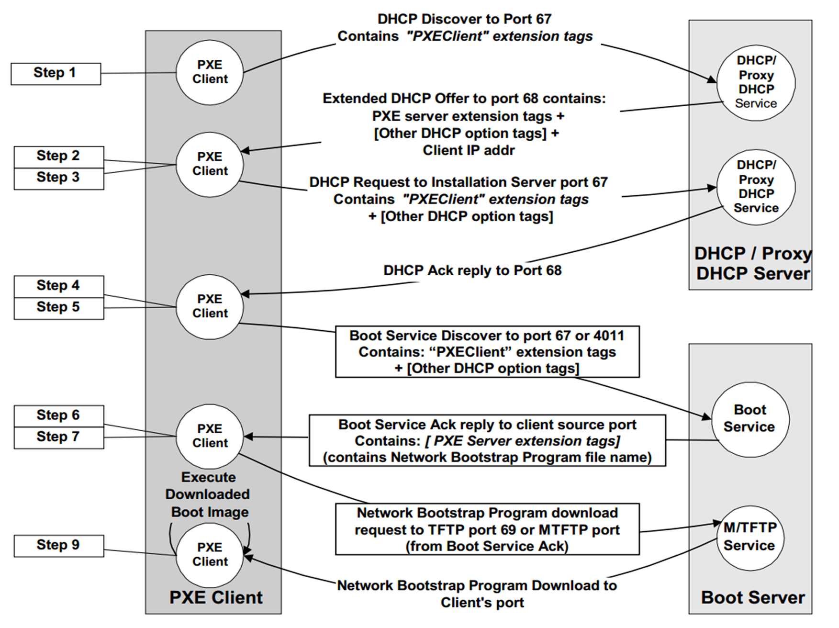
PXE server

Slide 27
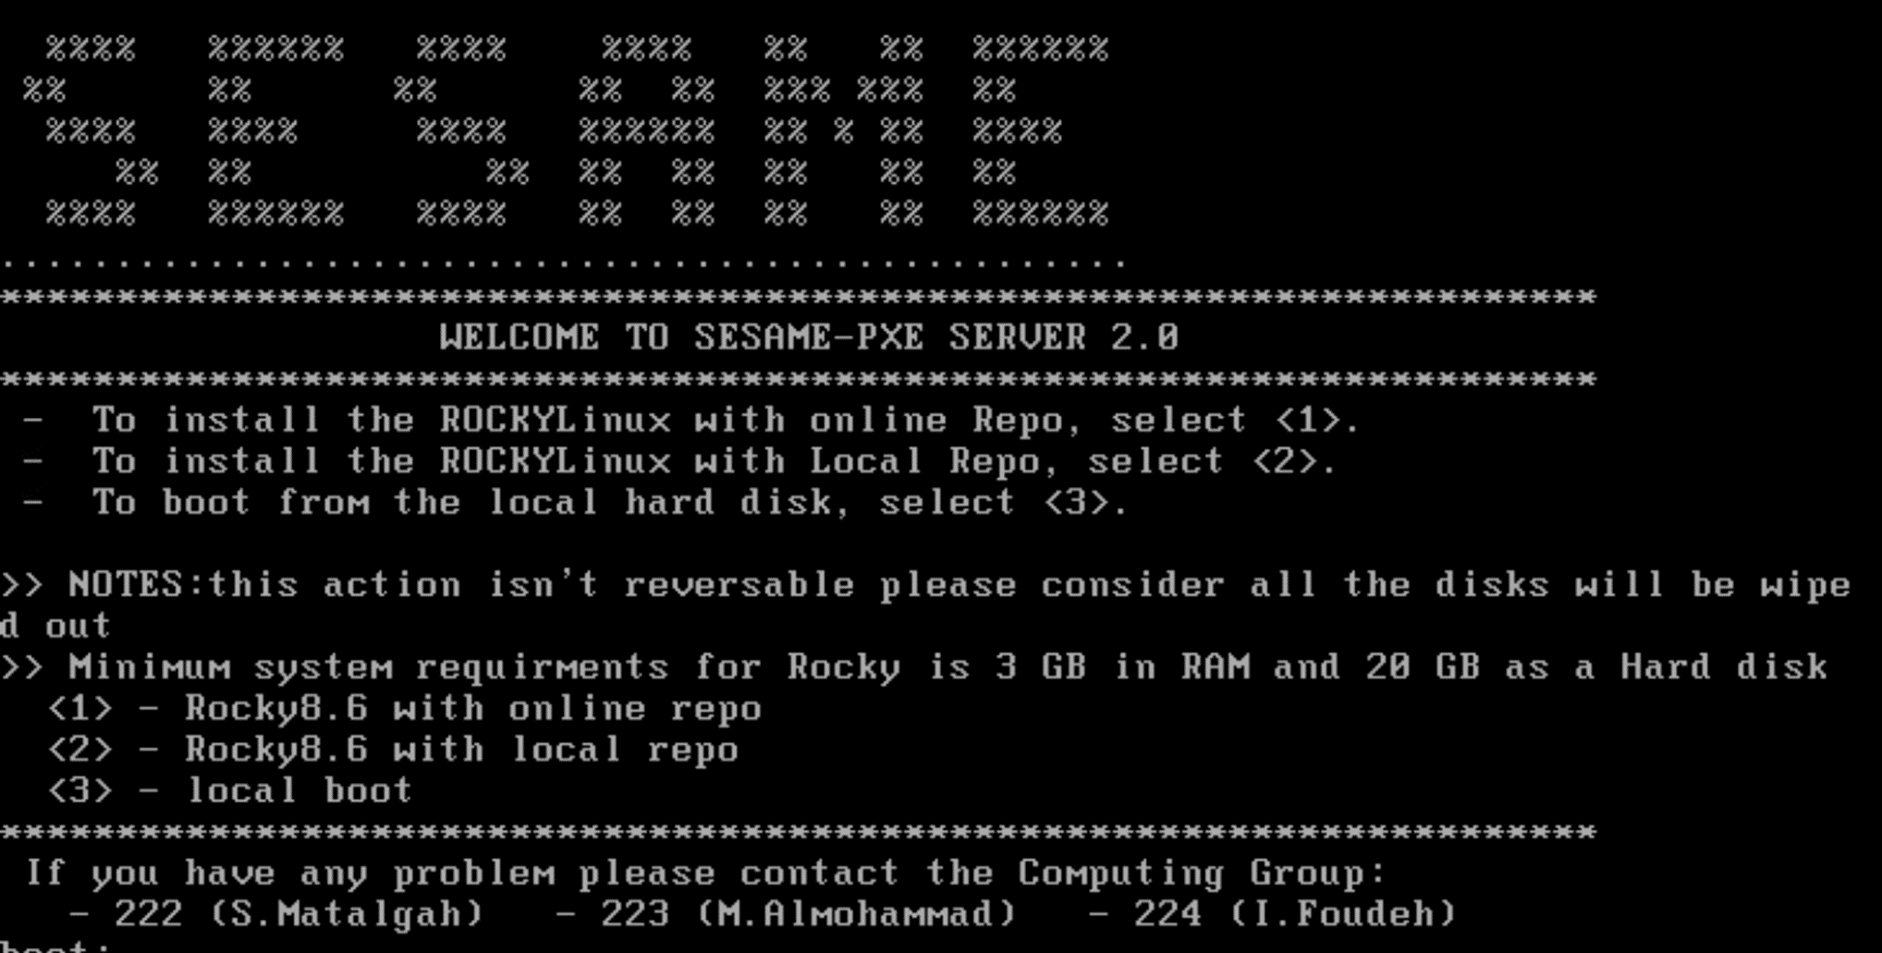
PXE server

Slide 28
Questions?

Slide 29
Thank You

