Slide 1
Containerization with Docker
Amro Aljadaa
Control Software Engineer
SESAME

Slide 3
What is containerization
Containerization is the packaging of software code with just the operating system (OS) libraries and dependencies required to run the code to create a single lightweight executable - called a container - that runs consistently on any infrastructure [1]

Slide 4
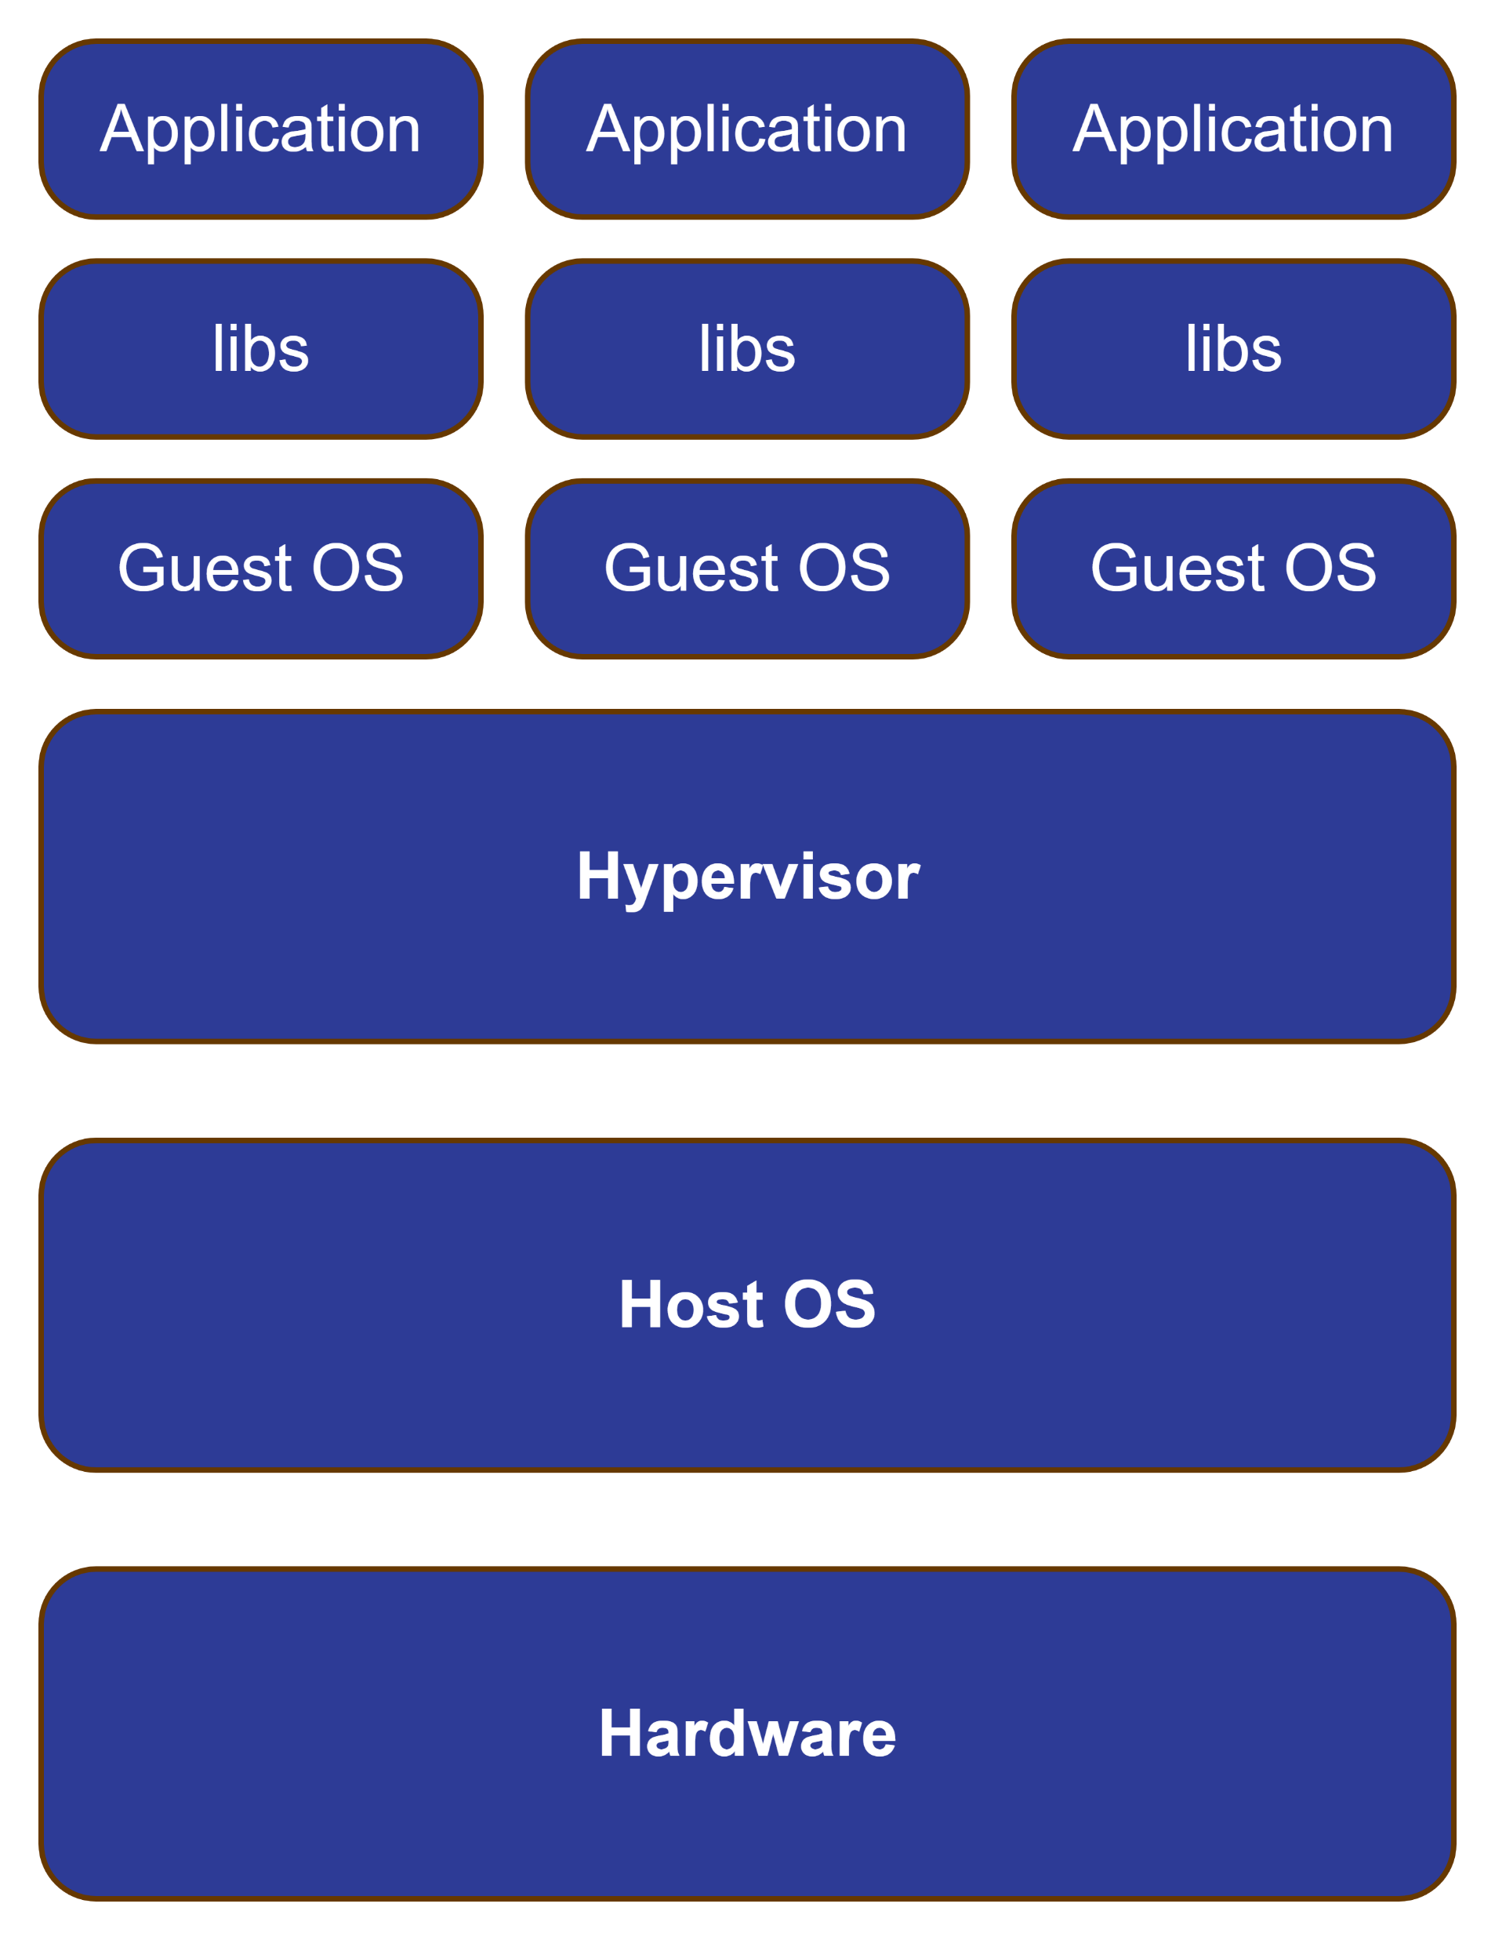
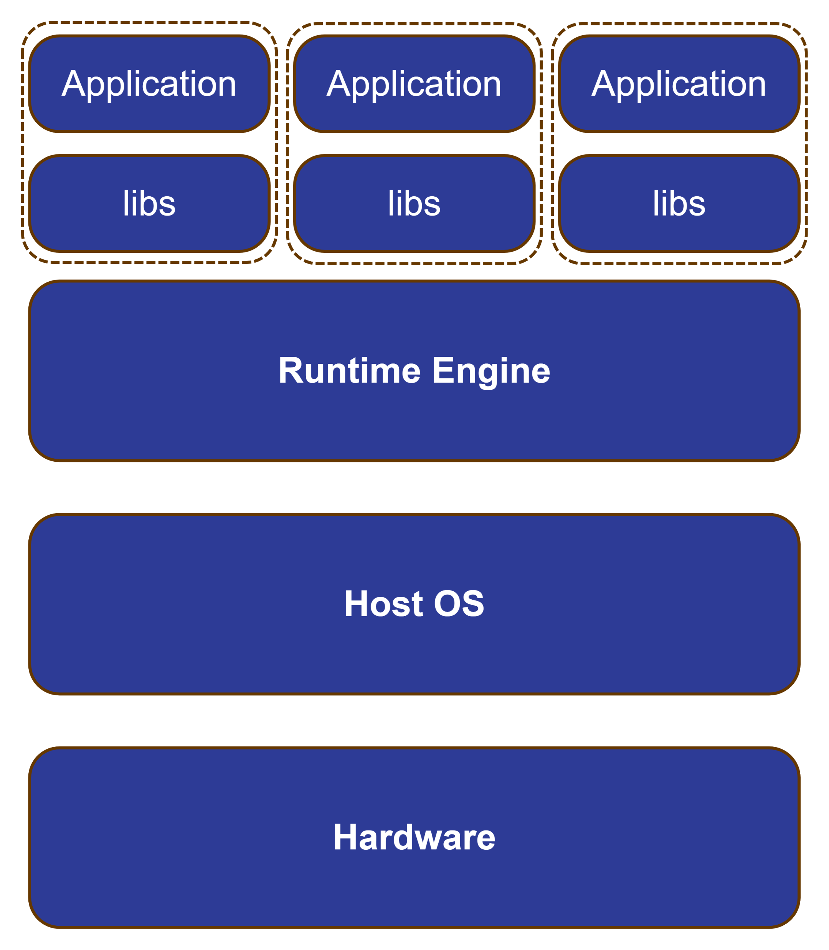
Container Vs Virtual Machine [1]
Guest OS and libraries are included on every VM when we want to scale
Container Architecture
VM
Architecture

Slide 5
Container Vs Virtual Machine [1]
Containers are more portable and resource-efficient than virtual machines
Containers are lightweight. They share the machine’s operating system (share the same OS kernel)
Containers are smaller than VMs
Containers require less start-up time than VMs

Slide 6
Isolation
Namespaces
Namespaces are a feature of the Linux kernel that partition kernel resources such that one set of processes sees one set of resources, while another set of processes sees a different set of resources [2]
It isolates various aspects of a process such as PID, network, etc.
Cgroups (control groups)
is a Linux kernel feature that limits, accounts for, and isolates the resource usage (CPU, memory, disk I/O, etc.) of a collection of processes [3]
Notes:
Namespace cmd:
$ sudo unshare --fork --pid --mount-proc bash
$ ps aux
$ exit
Cgroups cmd
$ sudo mkdir /sys/fs/cgroup/cpu/mycgroup
Limit CPU usage to 20% (given 100,000 as full CPU time slice):
$ echo 20000 | sudo tee /sys/fs/cgroup/cpu/mycgroup/cpu.cfs_quota_us
Move the current shell process into the cgroup.
$ echo $$ | sudo tee /sys/fs/cgroup/cpu/mycgroup/cgroup.procs
To remove the cgroup:
$ sudo rmdir /sys/fs/cgroup/cpu/mycgroup

Slide 7
Isolation [4]
Using containers during the development process gives the developer an isolated environment that looks and feels like a complete VM. It’s not a VM, though – it’s a process running on a server somewhere.
If the developer starts two containers, there are two processes running on a single server somewhere – but they are isolated from each other.
Container runtimes like Docker, rkt, and podman make things easier by creating namespaces on your behalf

Slide 8
Container runtime [5]
A container runtime is the foundational software that allows containers to operate within a host system
It is responsible for
Pulling container images from the registry
Running containers on the system
Managing containers’ life cycles
Monitoring their health, restarting them if they fail, and cleaning up resources once the containers are no longer in use
Allocating and regulating CPU, memory, and I/O for each container to prevent resource monopolization

Slide 9
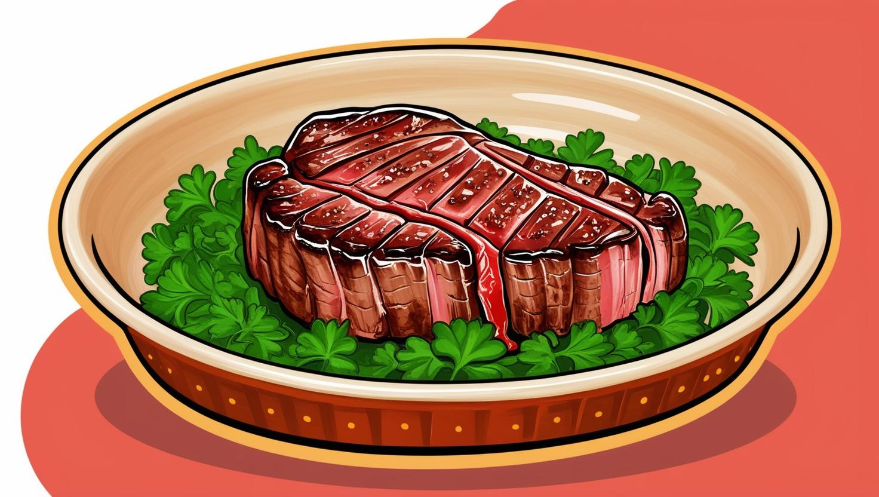
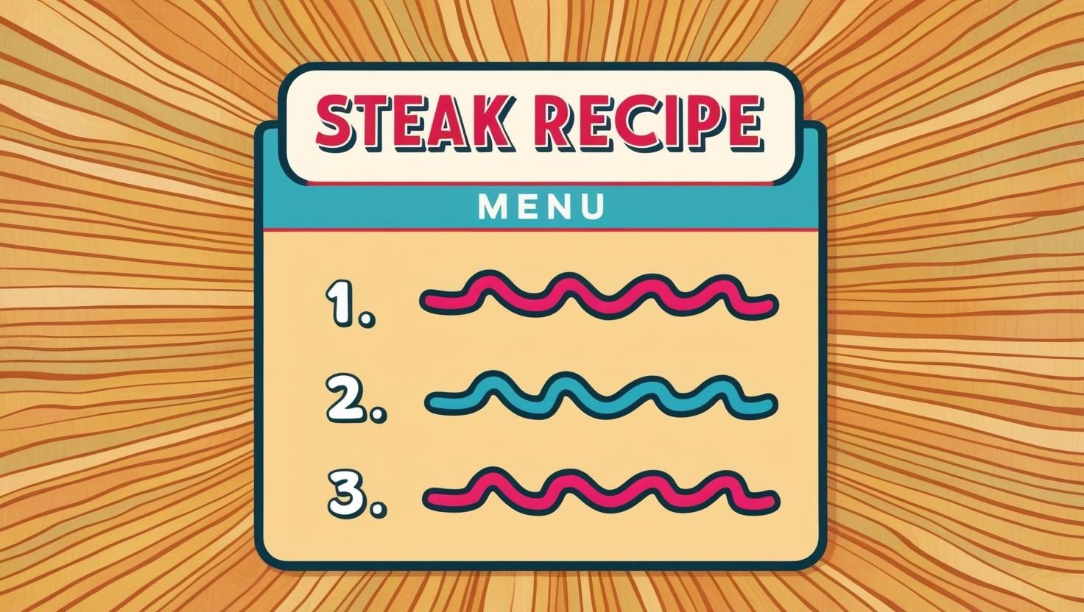

Slide 10
Docker Image - Analogy
Docker image = recipe
Container = dish
The Recipe is the blueprint to prepare the dishes
Docker image is the blueprint (template) to create containers
For free recipes, check dockerhub!

Slide 11
Docker Image - Naming
Standard Format:
[REGISTRY_HOST[:PORT]/][NAMESPACE/]REPOSITORY[:TAG]
Default Registry: docker.io
Default tag: latest
Examples:
docker.io/python:latest → same as python
MyRegistry/myImage:v2
MyRegistry/MyNamespace/myImage:latest

Slide 12
Lab - Managing Docker containers
Commands you may need
docker pull
Related commands: docker push, docker tag
docker image list
docker run/stop
docker ps
docker log
docker exec
docker inspect

Slide 13
Issues!
What if you don’t find the image you want in dockerhub that is specific to your task and requirements?
What if you want to run your own app that has a set of specific dependencies, and you want to package them together?
What if you want to run a specific startup command?
What if you want to reproduce the same environment every time on any machine?
In such cases, you need a way to write a recipe (set of instructions) to summary all of your requirements, and share them with the team

Slide 14
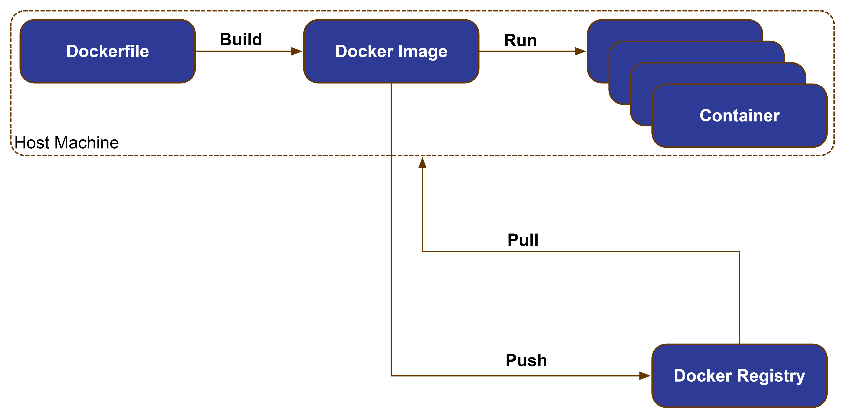
Workflow
Dockerfile is the Manifest that has the instructions for building the docker image
$ docker build <Dockerfile>
Docker image is the blueprint
Containers are running instances of an image
Containers are ephemeral
Docker Registry
Online
Private

Slide 15
Dockerfile example
Instruction | Description [5]
FROM | Create a new build stage from a base image
COPY | Copy files and directories
RUN | Execute build commands
CMD | Specify default commands It tells Docker what to do when the container starts
ENV | Set environment variables

Slide 16
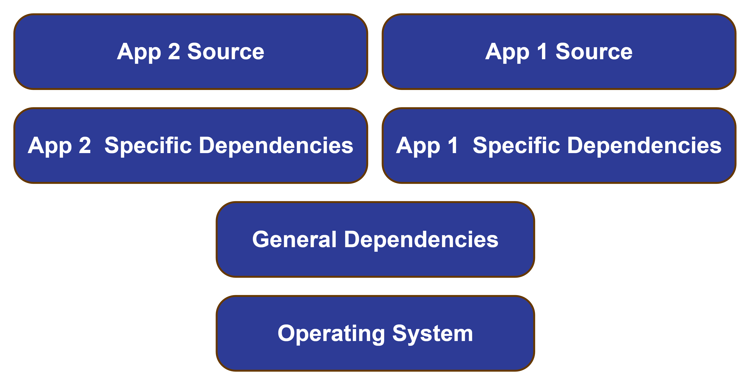
Image [6]
Docker image is composed of immutable layers
Each layer in an image contains a set of filesystem changes - additions, deletions, or modifications
Notes:
Advantages of layering:
1. Faster builds
2. Reduce the amount of storage and bandwidth required to distribute the images
3. Extending others images by reusing their base layer

Slide 17
Storage [7]
All files created inside a container are stored on a writable container layer that sits on top of the read-only, immutable image layers
Data written to the container layer doesn't persist when the container is destroyed

Slide 18
Storage [7] – Volume mounts
To store data outside of the writable layer of the container you can use one of the following methods:
Volume mounts
Bind mounts
tmpfs mounts
Named pipes

Slide 19
Containerization Advantages
Reduce development time
Using the multi-layer approach, you can implement common layers in sperate images and start with these images in your development of new features
Reduce deployment time
Whatever is the difference between the development and production environments, the deployment is seamless
It solves the problem of “It works on my machine!”

Slide 20
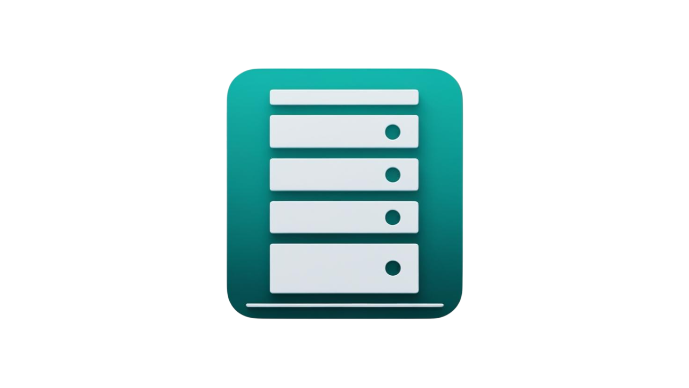
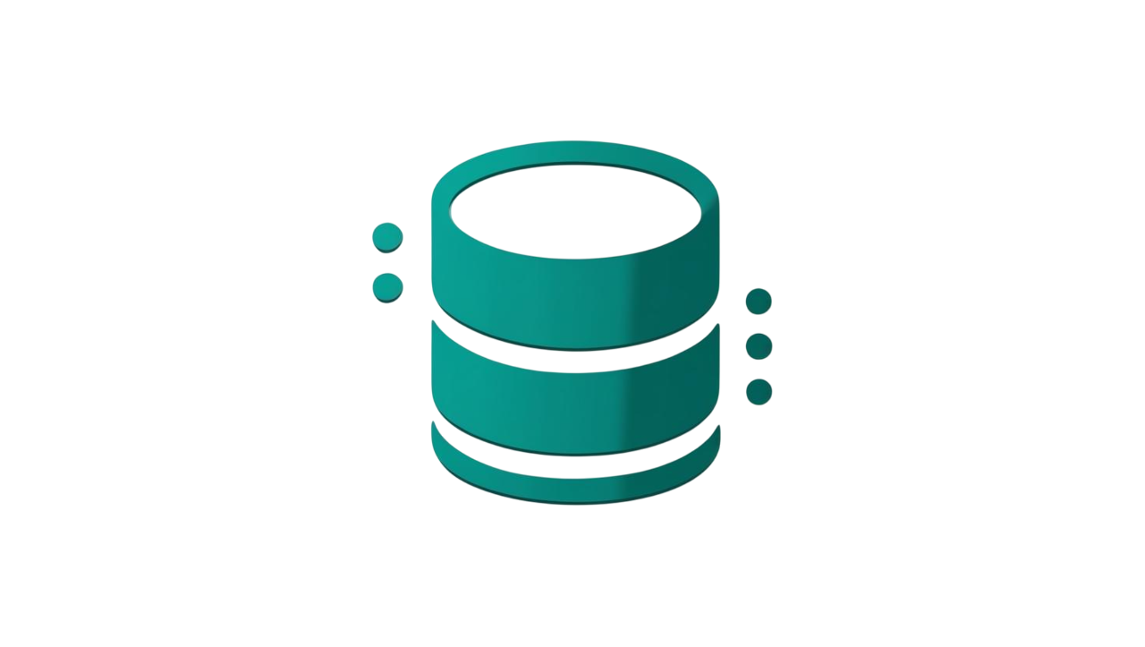
Multi Container Applications
Different containers with different purposes work together to run your application
Backend
Database

Slide 21
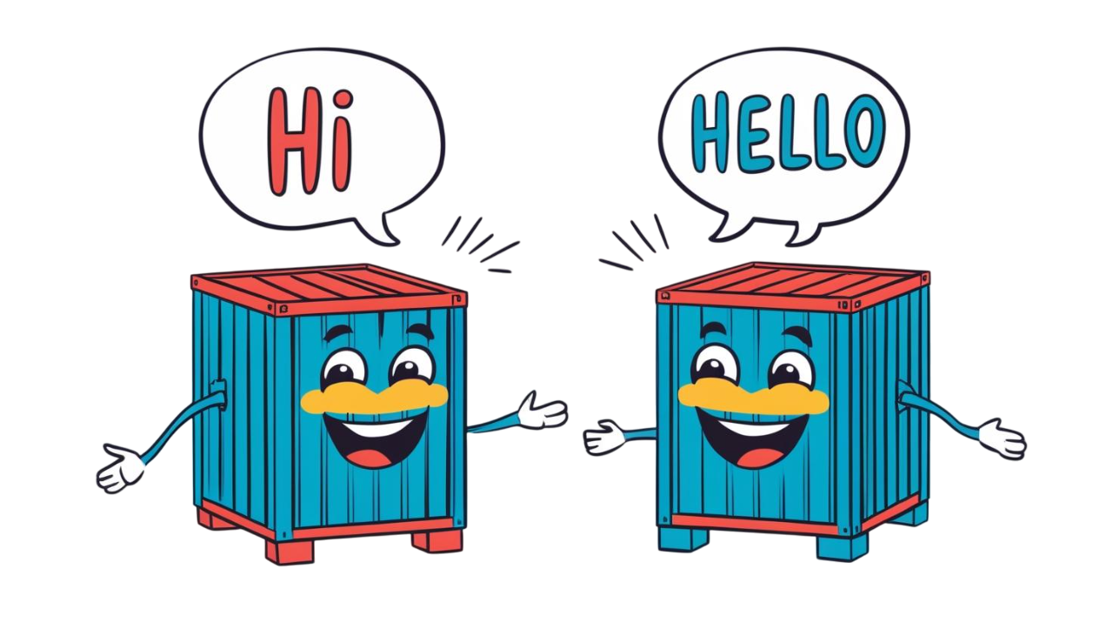
Networking [8]
Container networking refers to the ability for containers to connect to and communicate with each other, or to non-Docker workloads

Slide 22
Networking - Drivers [8]
bridge | The default network driver.
host | Remove network isolation between the container and the Docker host.
none | Completely isolate a container from the host and other containers.
overlay | Overlay networks connect multiple Docker daemons together.
ipvlan | IPvlan networks provide full control over both IPv4 and IPv6 addressing.
macvlan | Assign a MAC address to a container.
Notes:
Bridge: commonly used when your application runs in a container that needs to communicate with other containers on the same host
$ ip a s
realize the docker0 network. It is the virtual bridge network interface
Run sh inside the container and issue “ip a s”

Slide 23
Networking [8]
You can create custom, user-defined networks, and connect multiple containers to the same network
$ docker network create -d bridge <net-name>
$ docker run --network= <net-name> -itd --name=<name> <image>

Slide 24
Lab - Docker Compose [9]
Problem: it is hard to manage networks and create containers and assign them to networks manually
Docker Compose is a tool for defining and running multi-container applications
It makes it easy to manage services, networks, and volumes in a single, comprehensible YAML configuration file
With a single command, you create and start all the services from your configuration file

Slide 25
Lab - Docker Compose [9]
Commands you may need
docker compose up
docker compose down
docker compose logs <service?>
docker compose ps
docker compose stop

Slide 26
References
[1] IBM Think https://www.ibm.com/think/topics/containerization#:~:text=Containerization%20is%20the%20packaging%20of,runs%20consistently%20on%20any%20infrastructure
[2] Linux namespaces – Wikipedia https://en.wikipedia.org/wiki/Linux_namespaces
[3] cgroups – Wikipedia https://en.wikipedia.org/wiki/Cgroups
[4] What Are Namespaces and cgroups, and How Do They Work? https://blog.nginx.org/blog/what-are-namespaces-cgroups-how-do-they-work

Slide 27
References
[5] Dockerfile reference https://docs.docker.com/reference/dockerfile/
[6] Building docker images https://docs.docker.com/get-started/docker-concepts/building-images/
[7] Docker Storage https://docs.docker.com/engine/storage/
[8] Docker Networking https://docs.docker.com/engine/network/
[9] Docker Compose https://docs.docker.com/compose/

