Slide 1
Introduction to Kubernetes
Amro Aljadaa
Control Software Engineer
SESAME

Slide 2
Docker Problems
Docker is not enough for production
Deploying containers across many machines
Scaling
When you have a service that receives a lot of requests, you can increase the resources for that service by creating multiple containers for the same docker image
Running multiple containers using docker is done manually
No built-in automatic way to scale up/down based on traffic or CPU/Memory usage

Slide 3
Docker Problems
Load balancing
When you have a service that is served by multiple servers, you need to load balance the requests
If you want to do it using docker only, you have to manually assign IP address and ports
What to do when scaling?
Docker compose is local and not suitable for clusters
In K8s, the service acts as a load balancer. It gives virtual IP addresses
K8s distributes traffic automatically across healthy pods
Availability
If node fails, the containers on the node will stop and the services they serve will be lost
K8s can move the pod to a healthy node

Slide 4
What is Kubernetes [1]
Kubernetes is a portable, extensible, open source platform for managing containerized workloads and services (container orchestration)
The name Kubernetes originates from Greek, meaning helmsman or pilot
It manages the containers that run the applications and ensure that there is no downtime
K8s provides you with a framework to run distributed systems resiliently
It automatically manages and handles failures for your containerized applications

Slide 5
What is Kubernetes
Container Manager: It starts, stops, and monitors your containers
It checks the health of your apps and restarts them if something crashes
Load Balancer: It routes traffic to the right containers
Auto-Scaler: It can automatically scale up (more containers) or down based on need
Configuration Center: It handles environment settings, secrets, and persistent storage

Slide 6
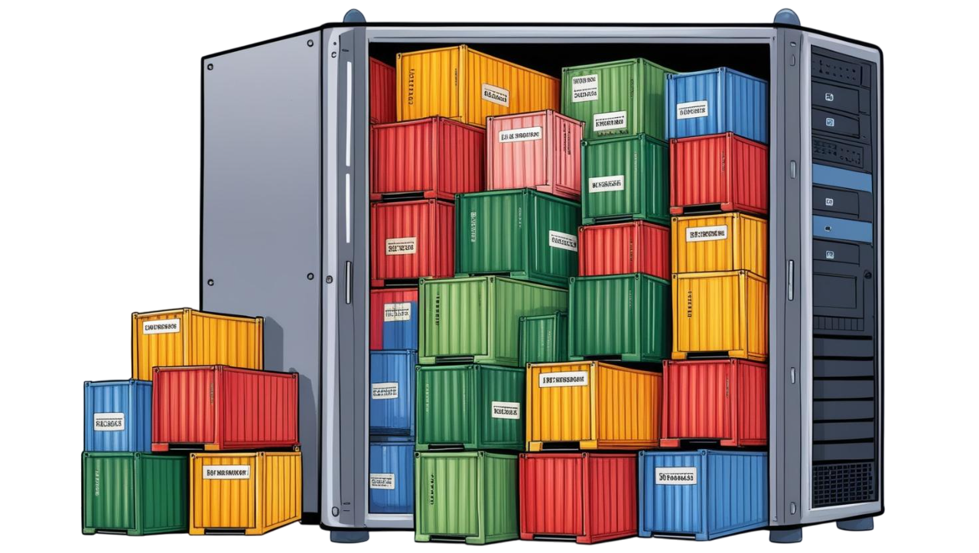
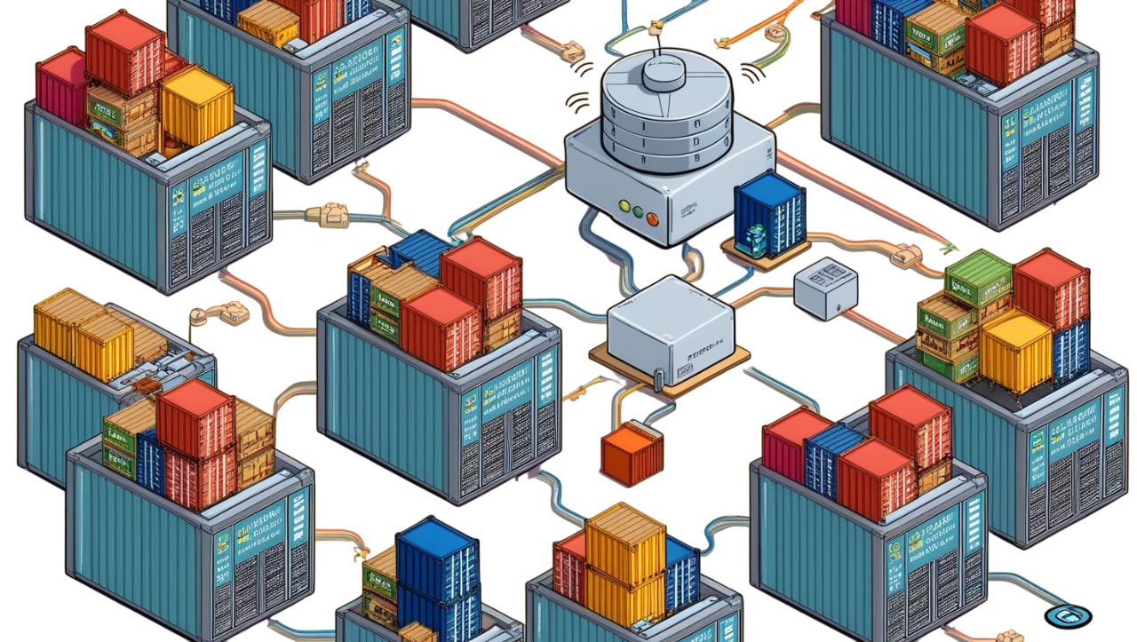
Docker compose Vs Kubernetes

Slide 8
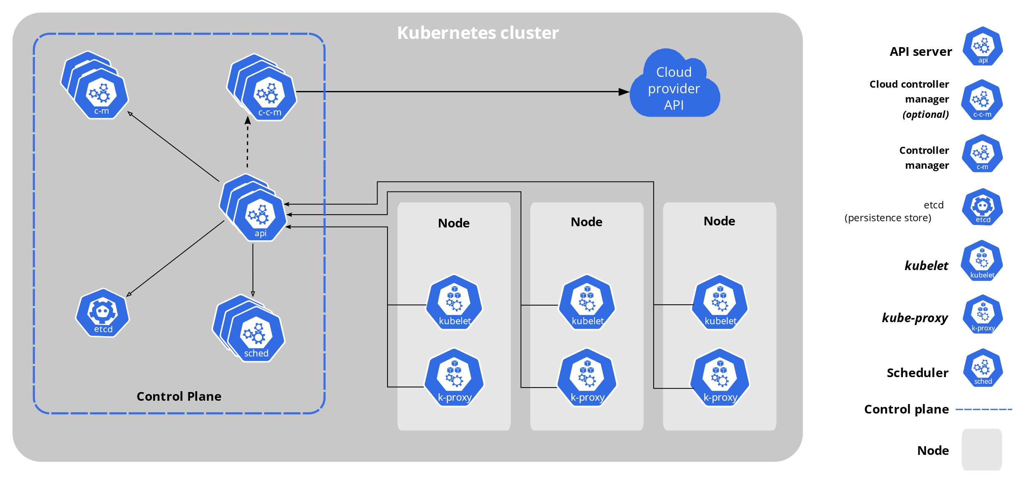
Kubernetes Architecture [2]

Slide 9
References
[1] https://kubernetes.io/docs/concepts/overview/
[2] https://kubernetes.io/docs/concepts/overview/components/

